Slide 1
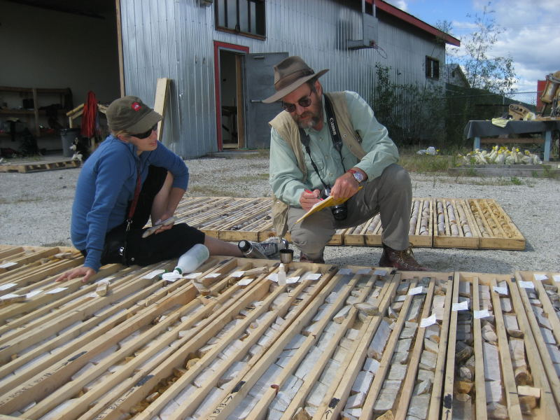
Porphyry field training course
Introduction to mapping porphyry Cu-Au
When - about November 14-21
Where – Orange district
Presenters – Greg Corbett and Doug Menzies
See – www.cmcgeos.com

Slide 2
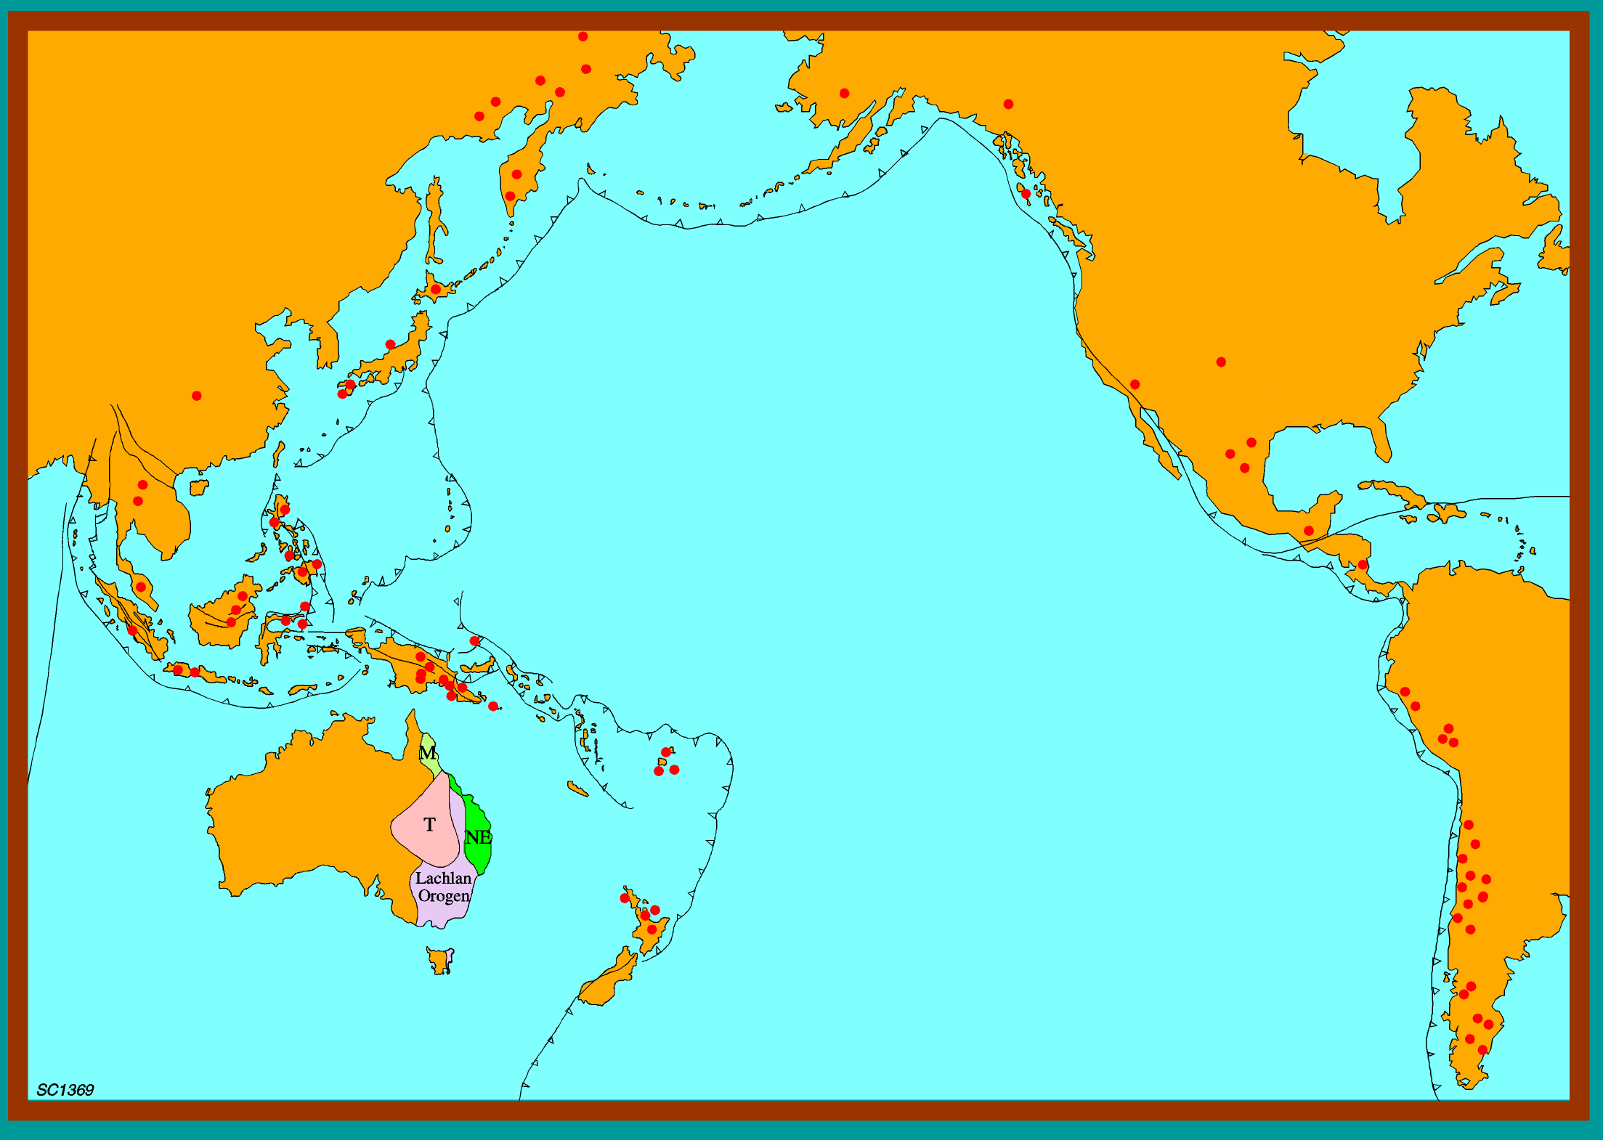
Exploration for Tasmanides Arc-style Cu-Au in a Pacific rim context
www.cmcgeos.com
www.corbettgeology.com
Greg Corbett
Corbett and Menzies Consulting

Slide 3
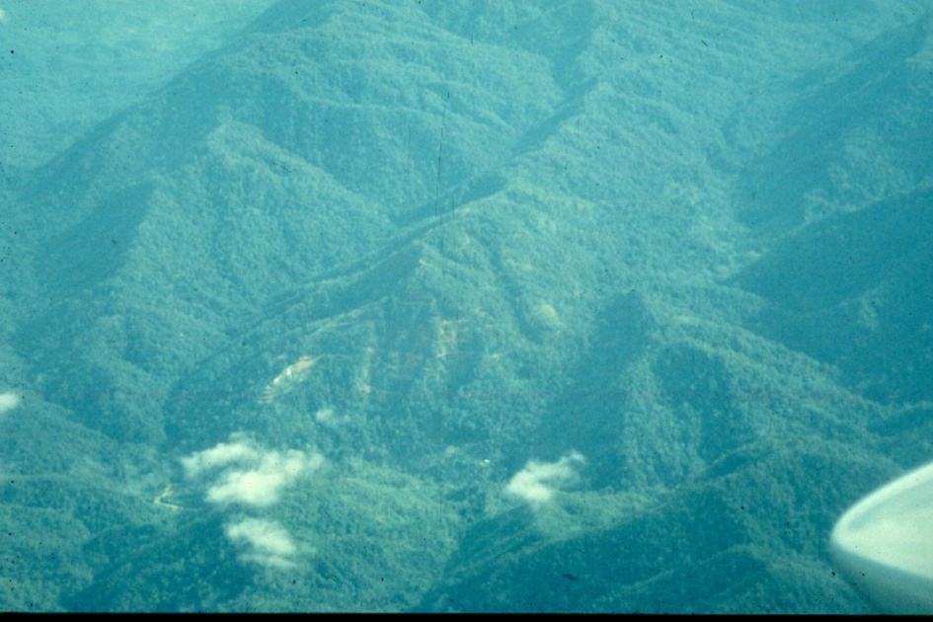
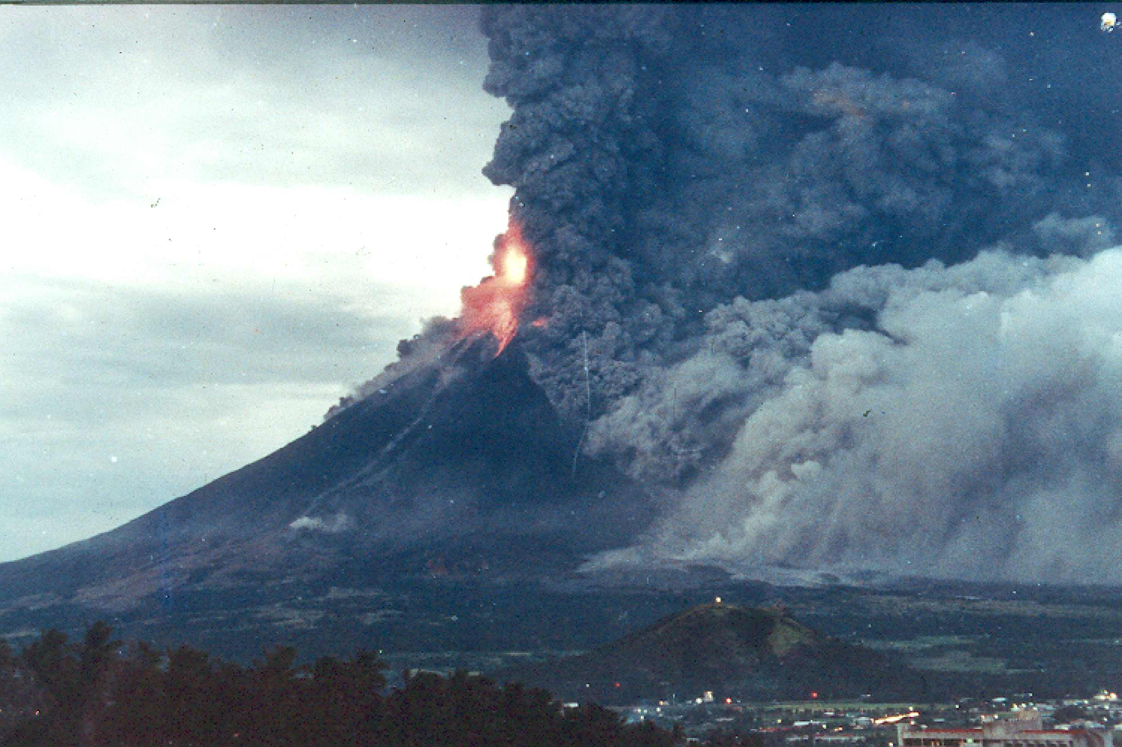
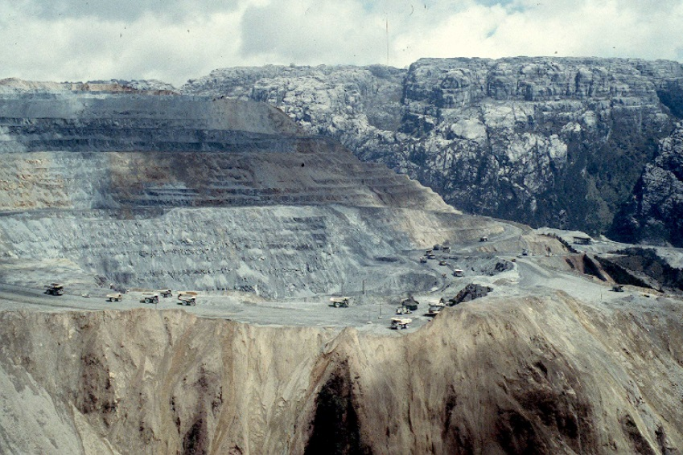
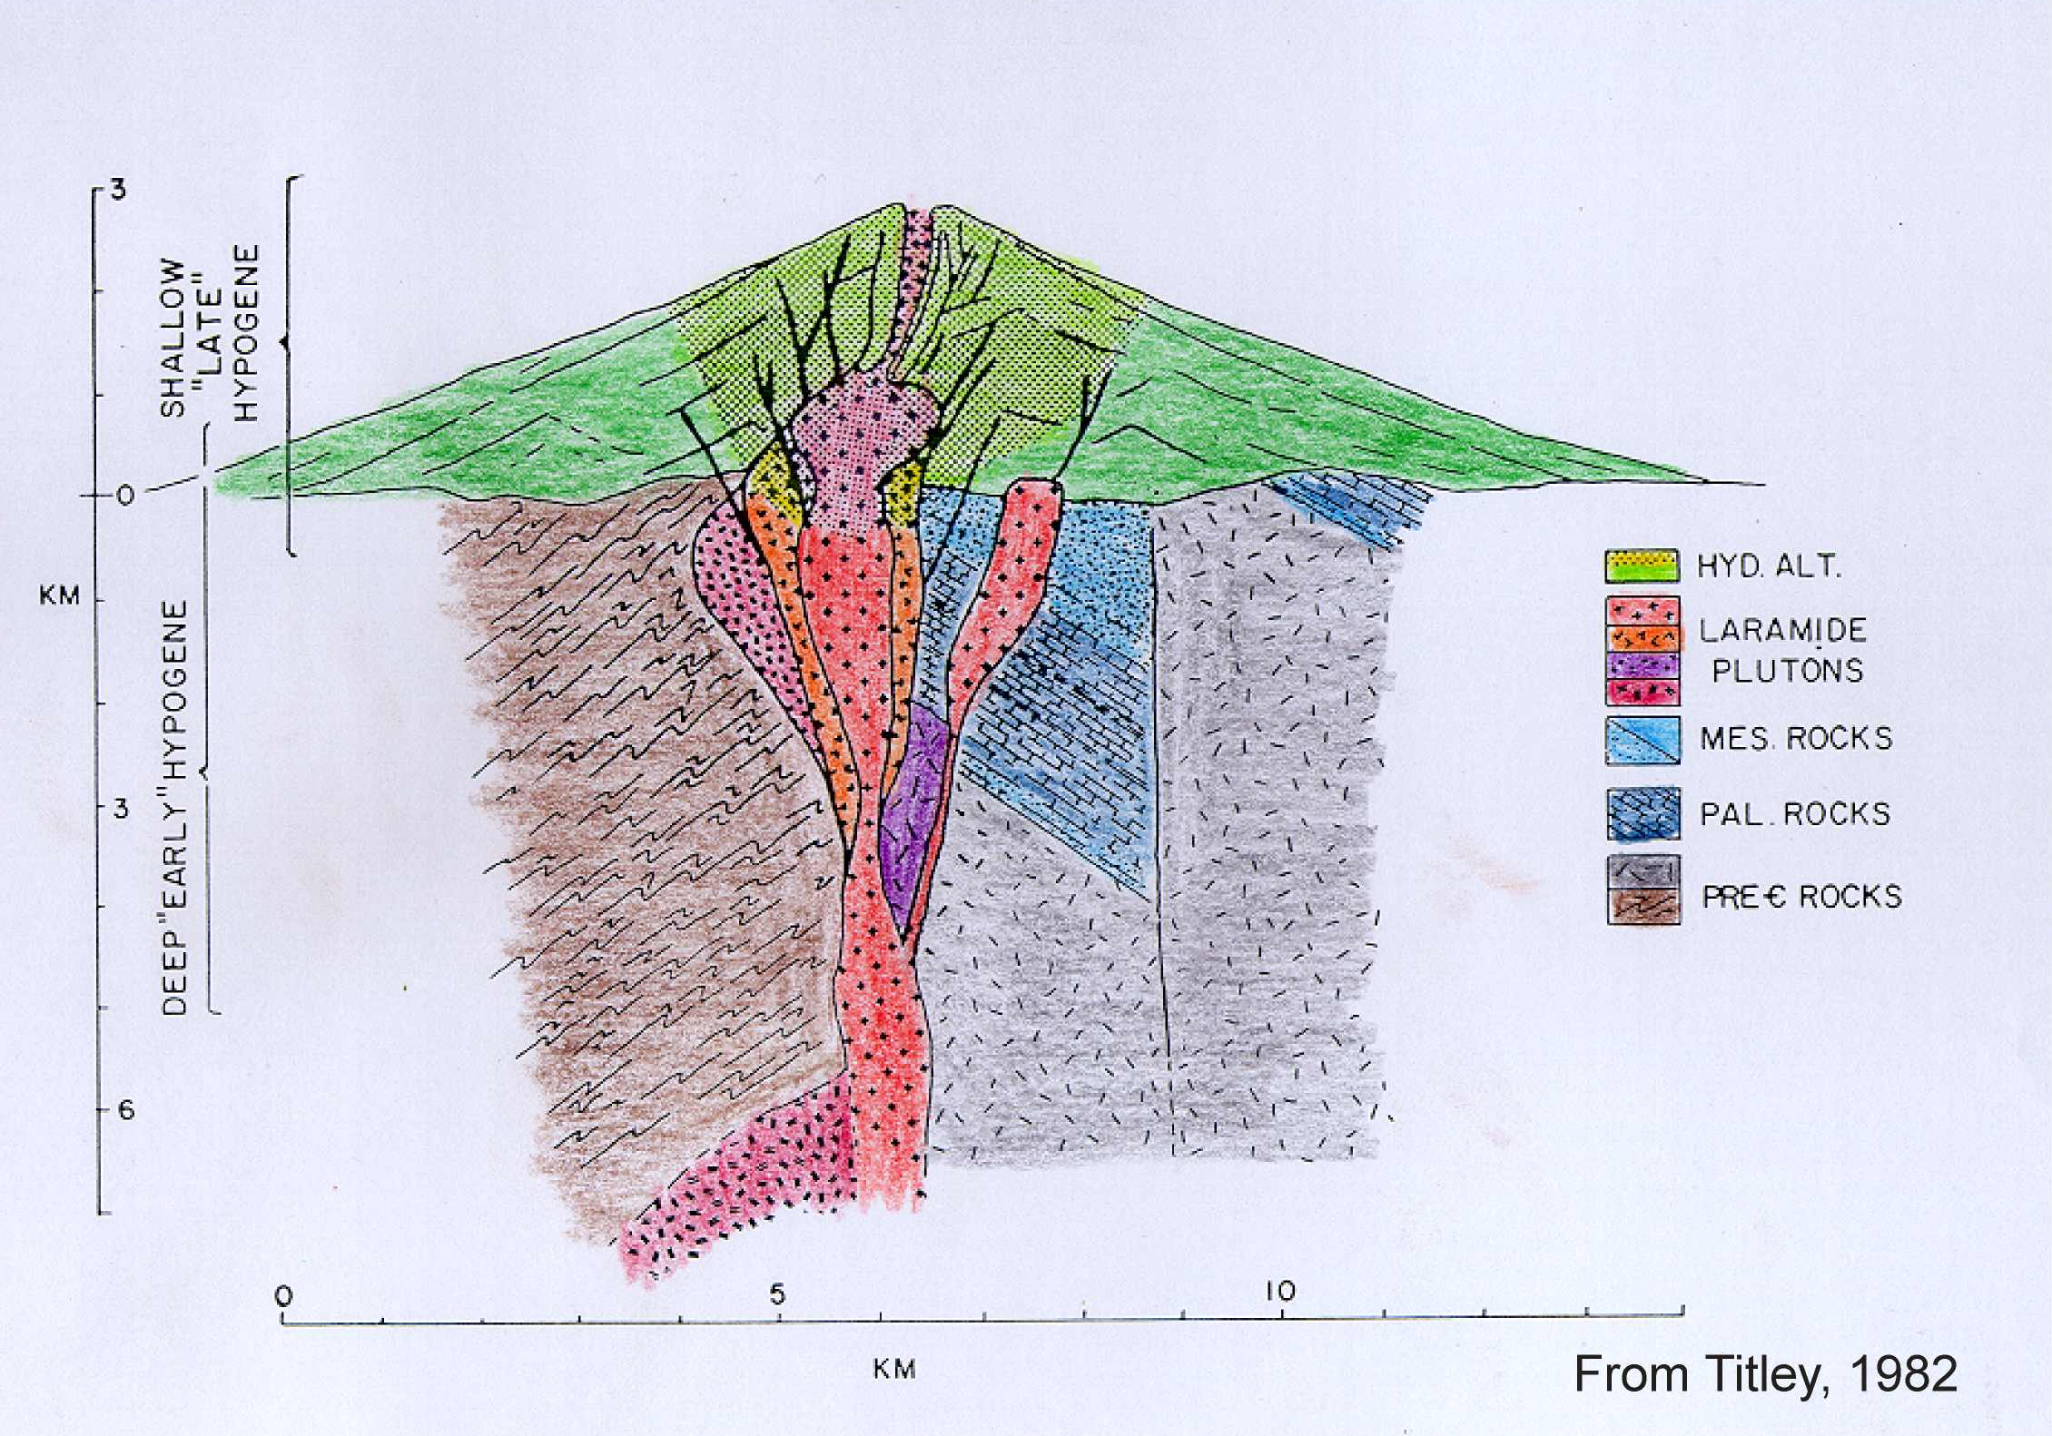
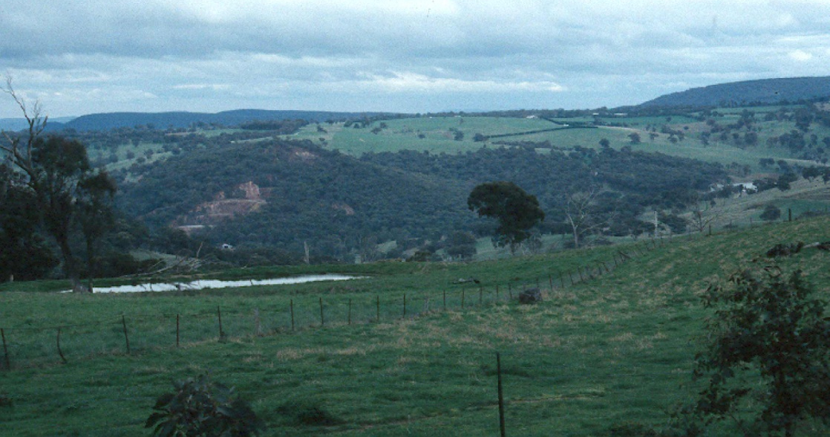
Porphyry setting
Wafi
Grasberg
Ridgeway

Slide 4
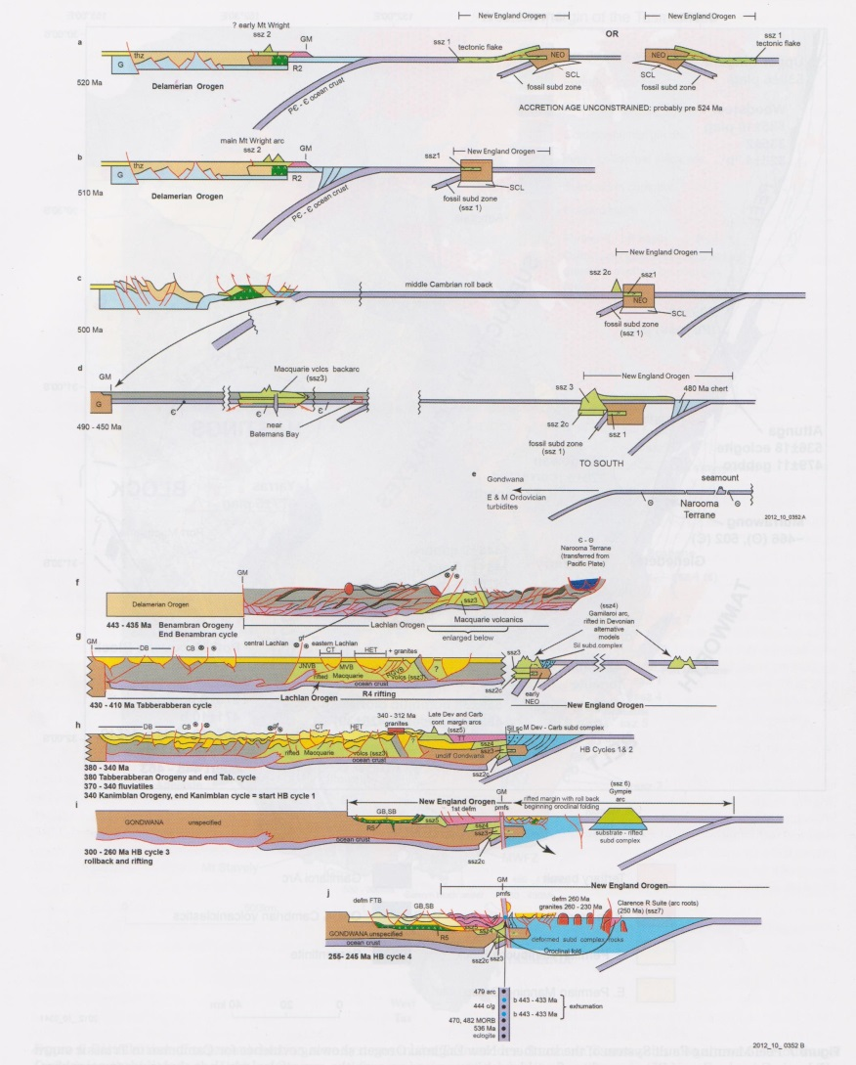
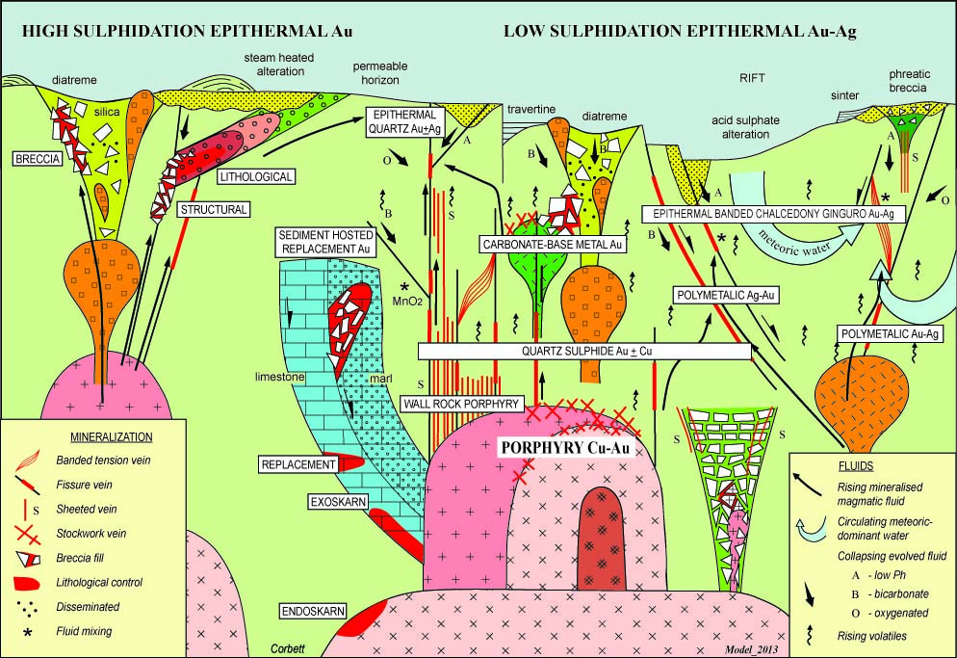
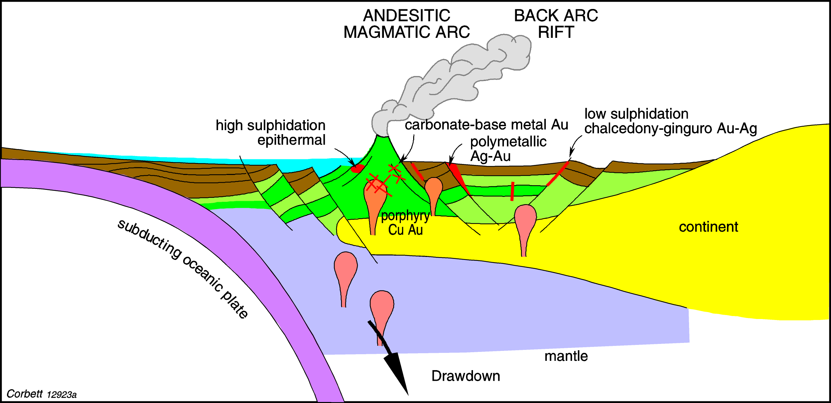
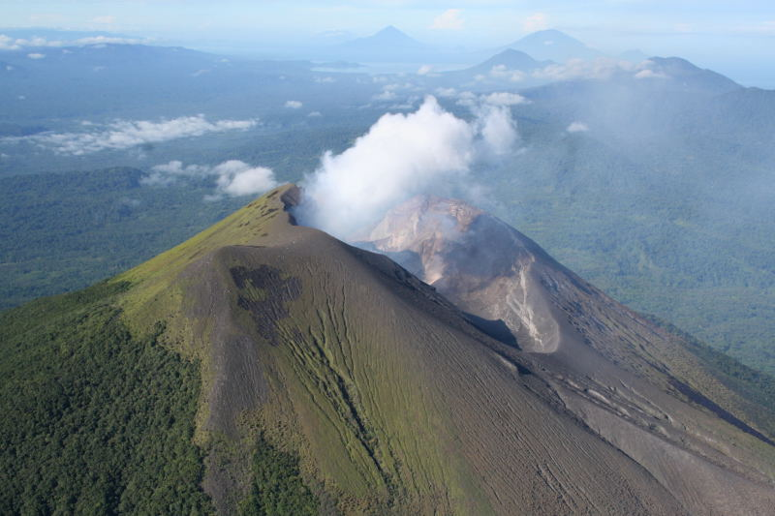
Roll back rather than magmatic arcs

Slide 5
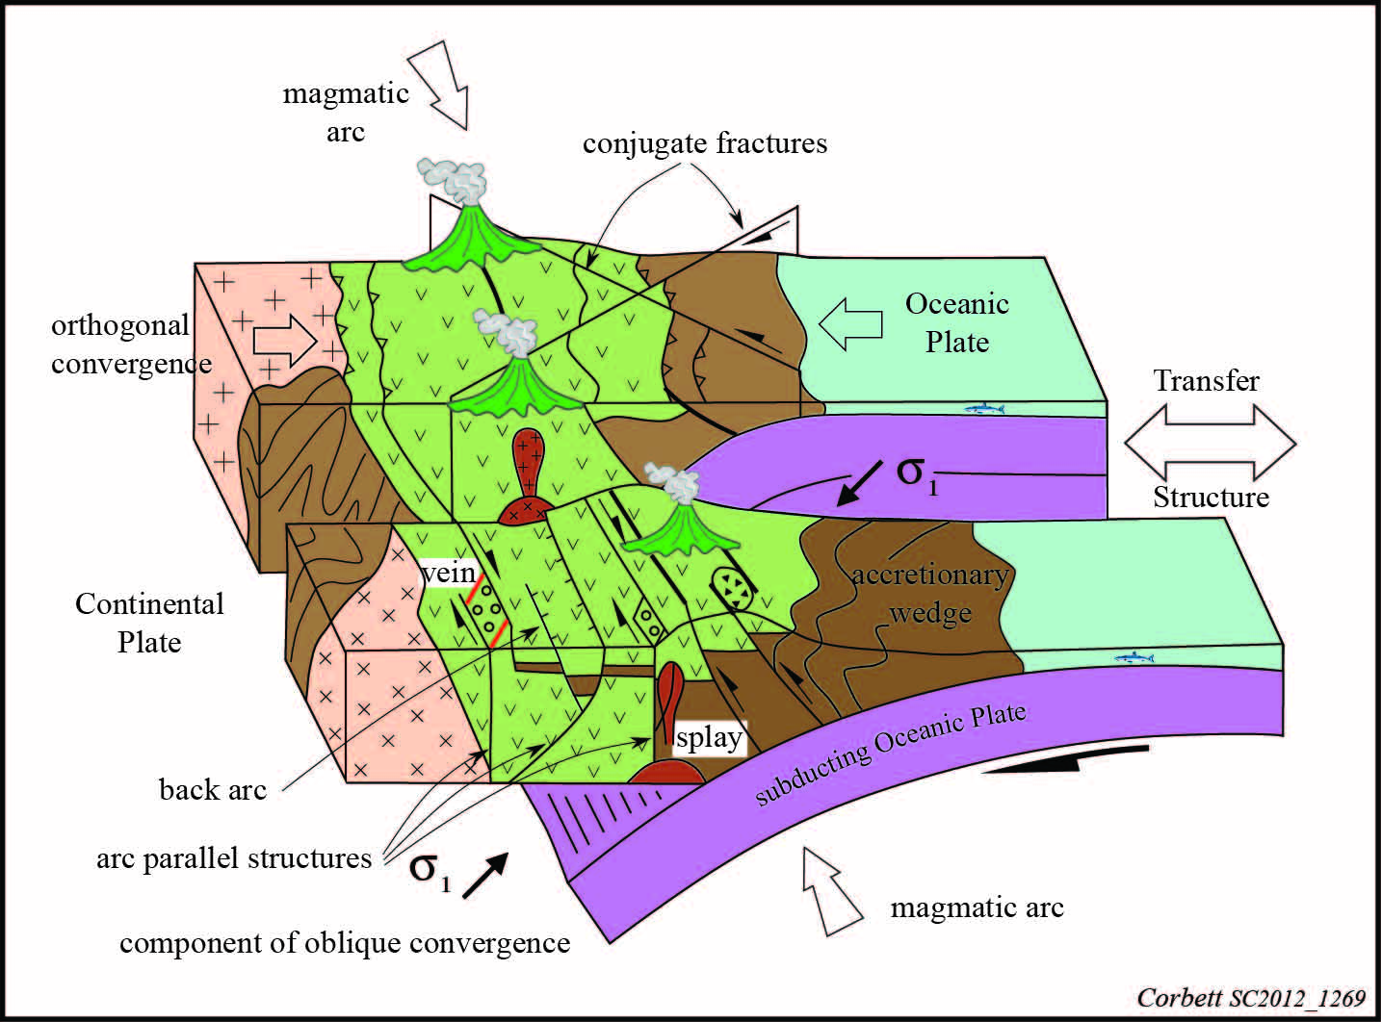
Structural control to porphyry Cu-Au

Slide 6
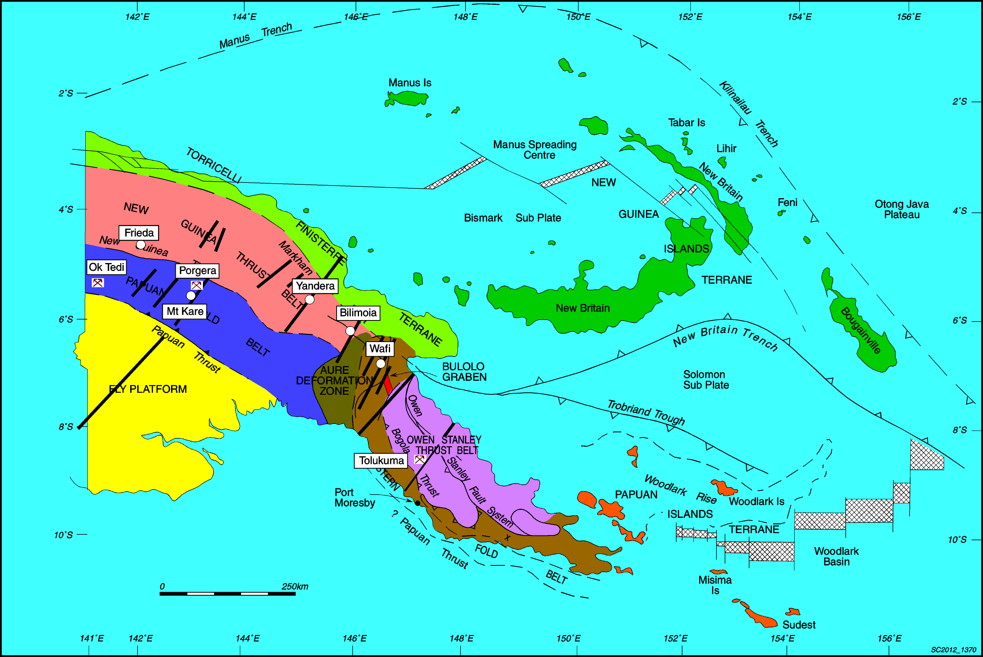
Transfer structures in Papua New Guinea
From Corbett 1994 on 2005 base

Slide 7
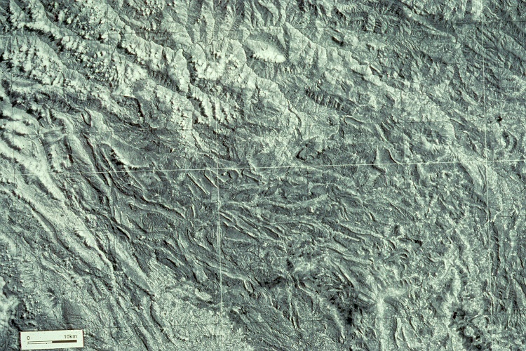
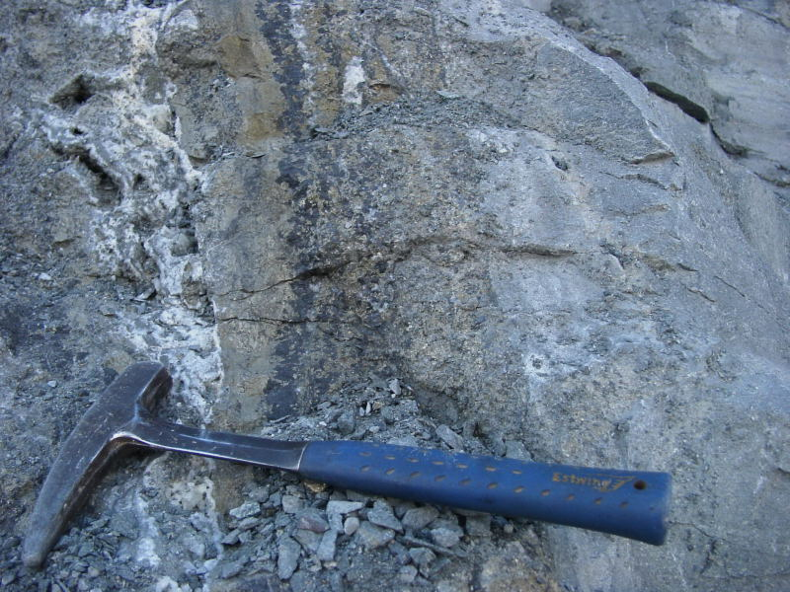
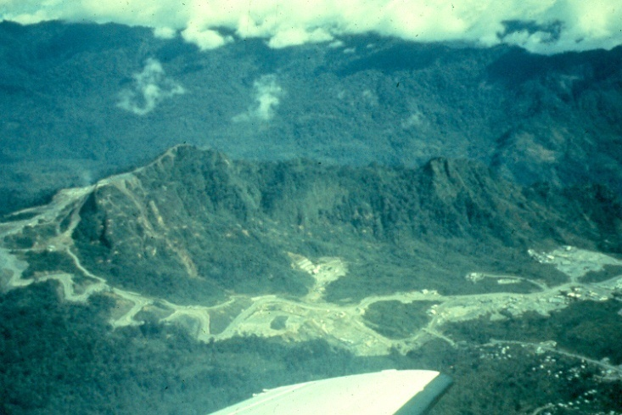

Porgera transfer structure

Slide 8

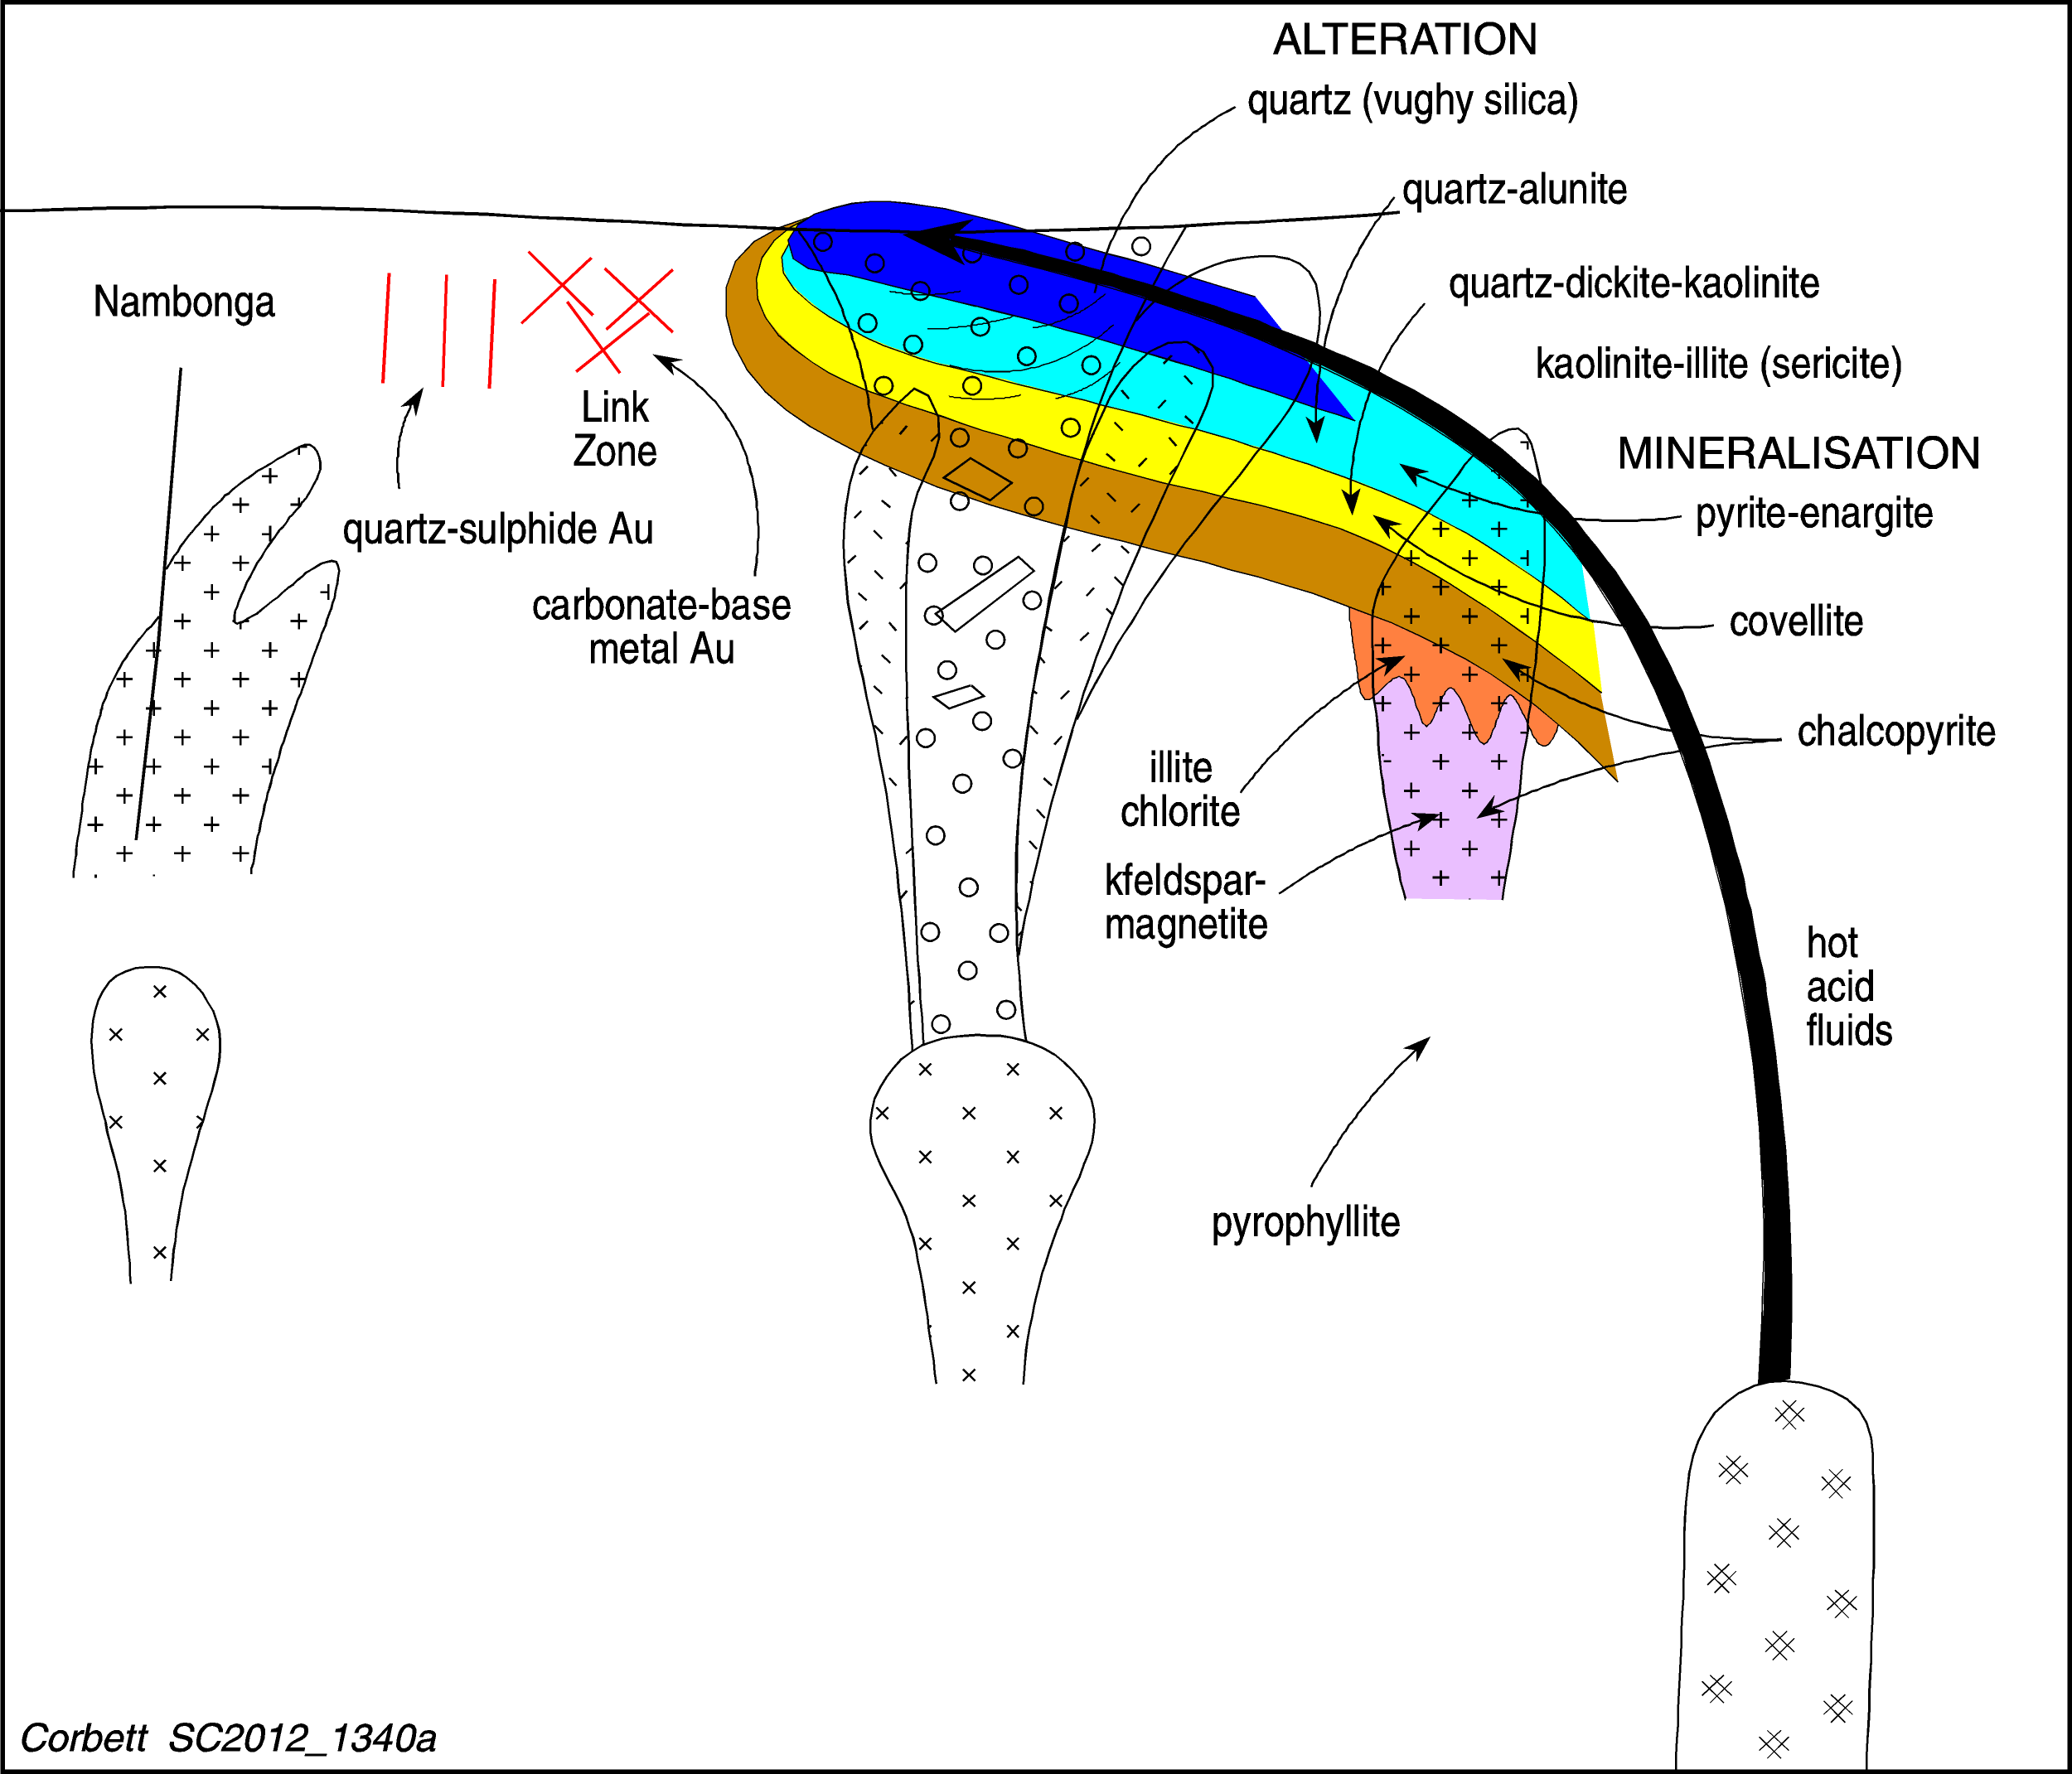
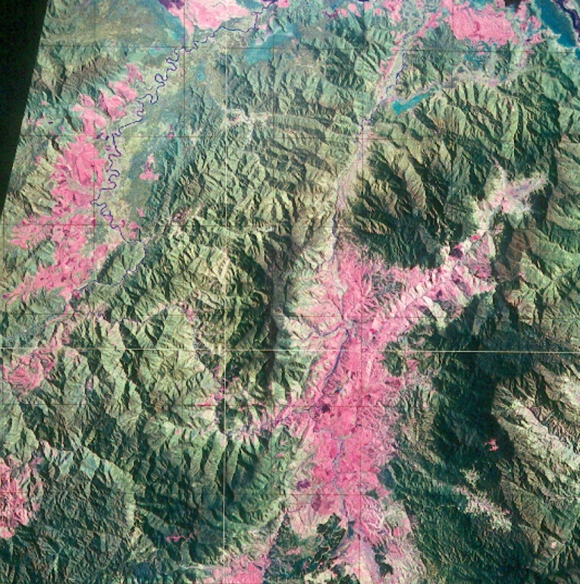
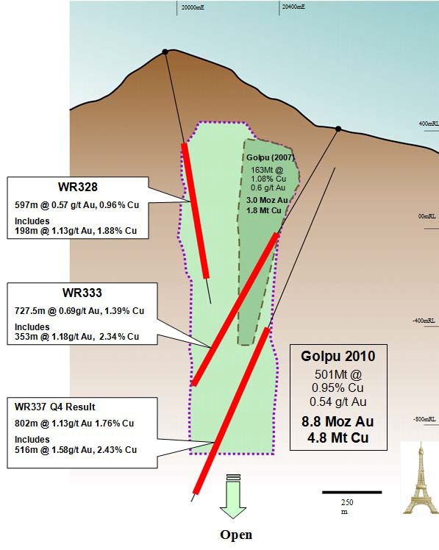
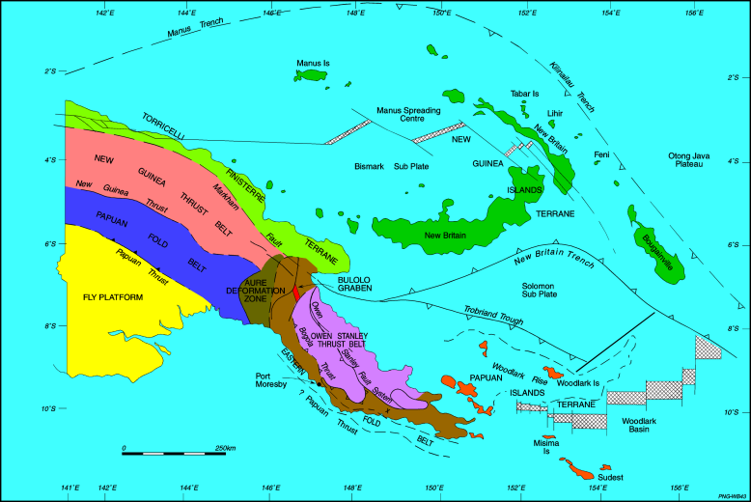
Wafi Alteration zonation

Slide 9
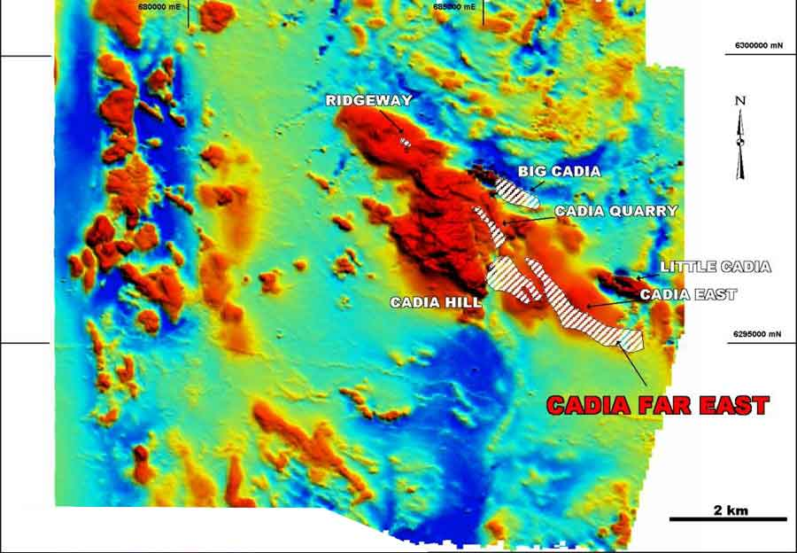
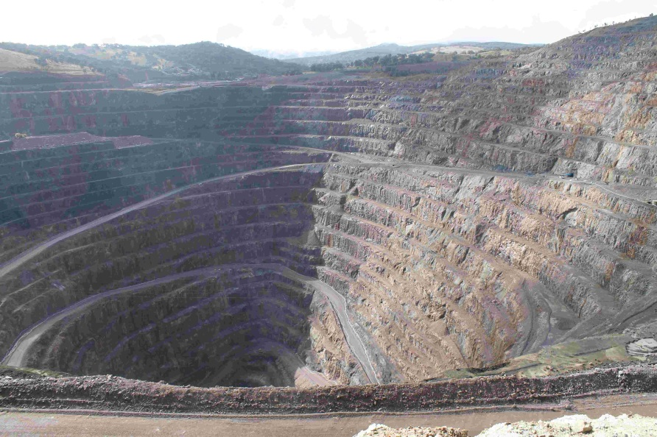
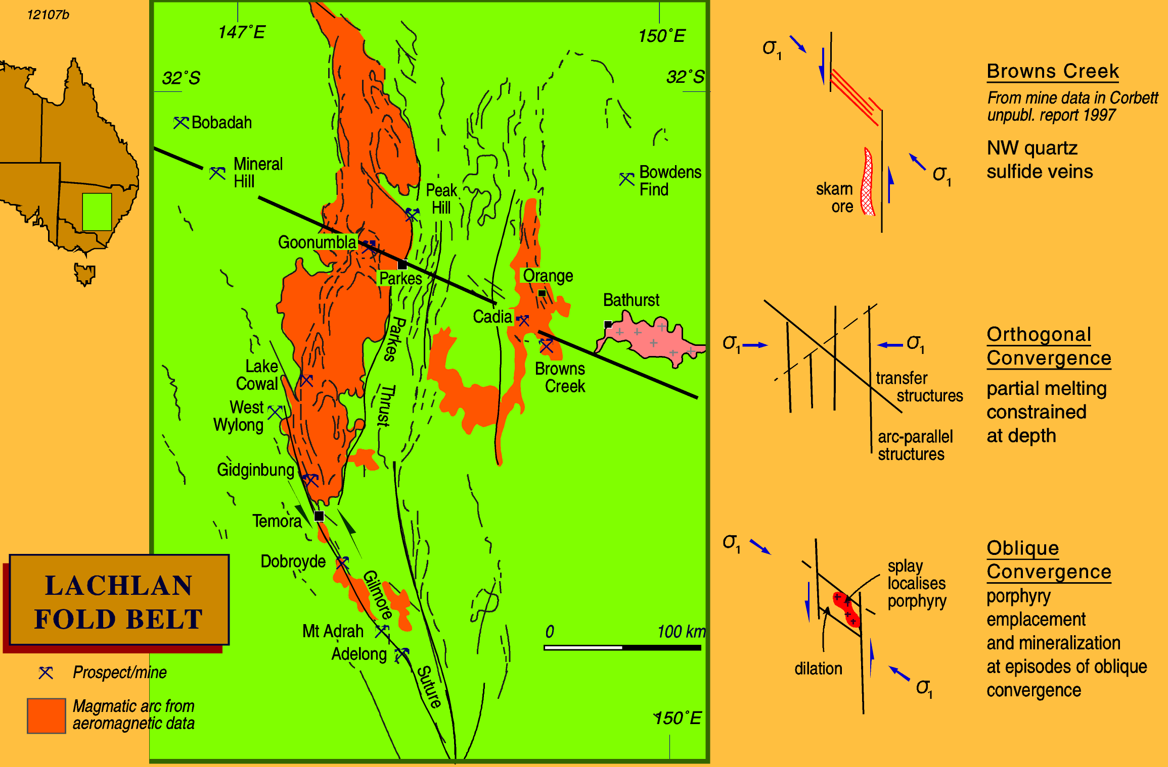
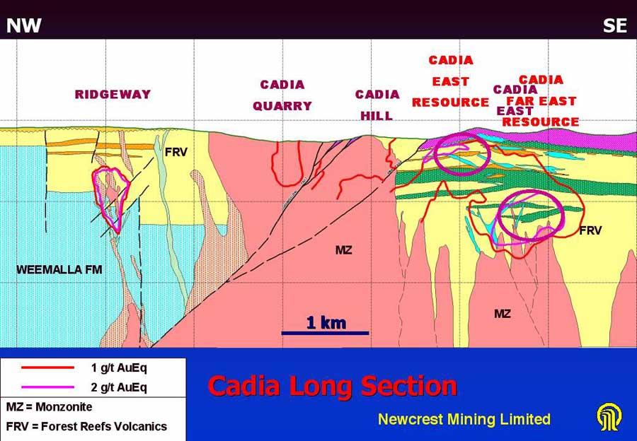
Cadia-Ridgeway & the Lachlan Transverse Zone
Cadia “Hill”

Slide 10
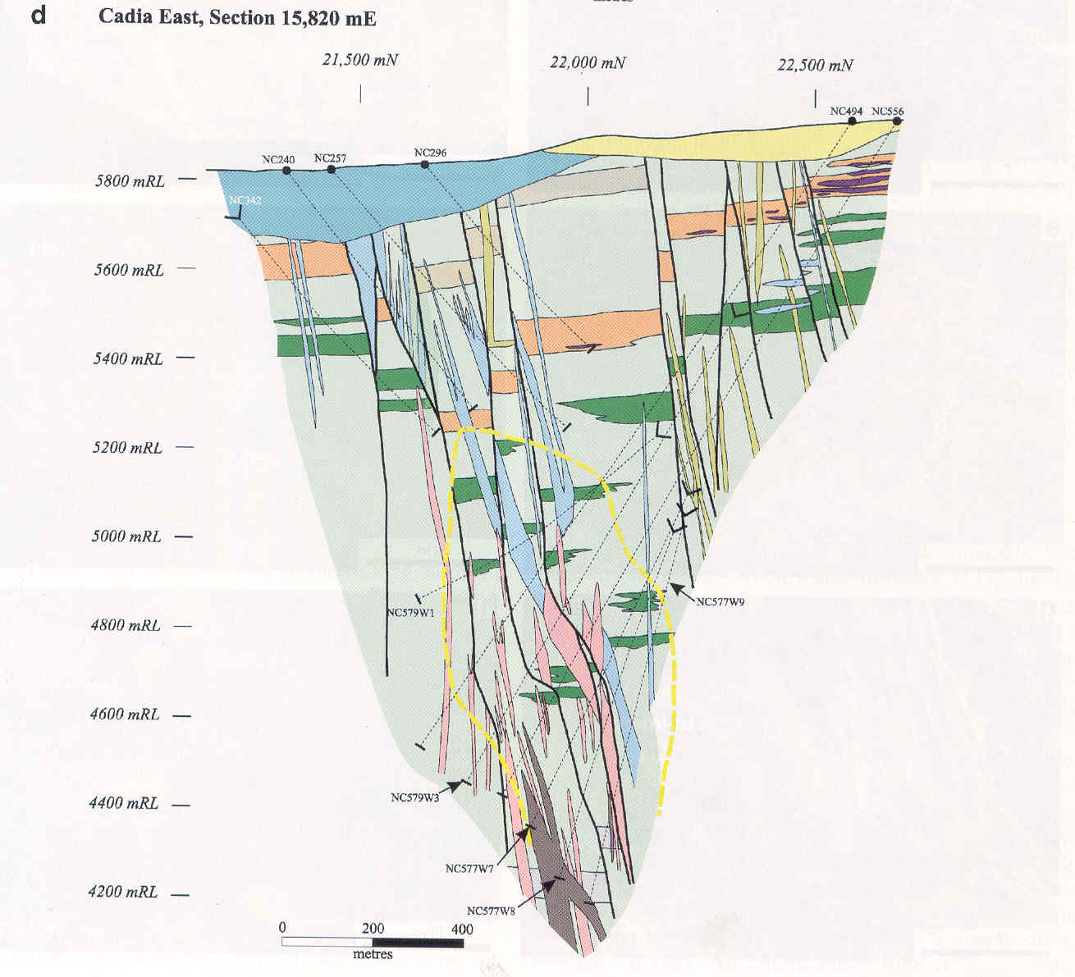
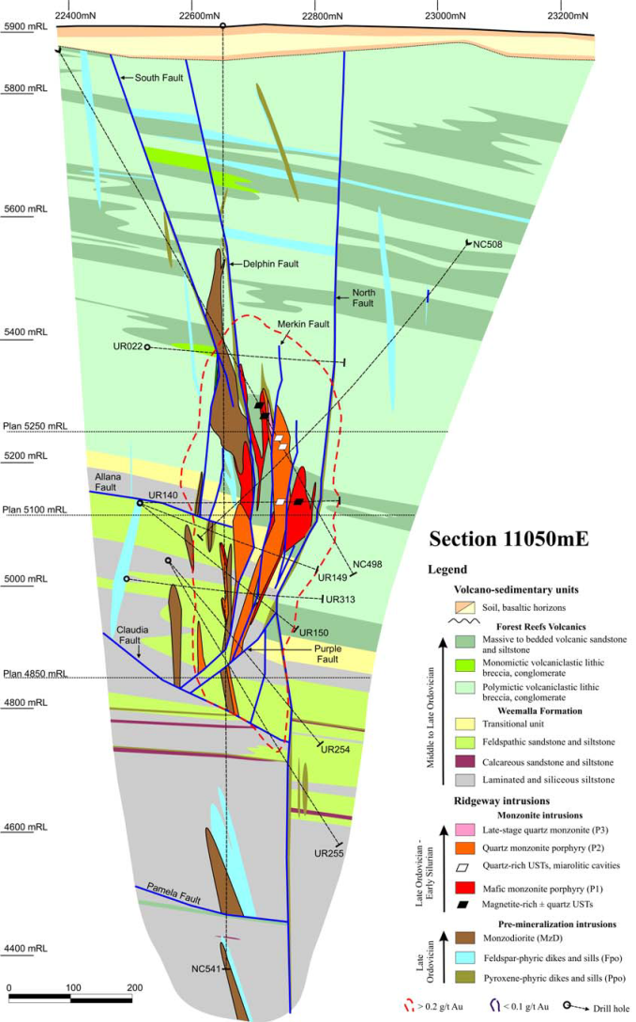
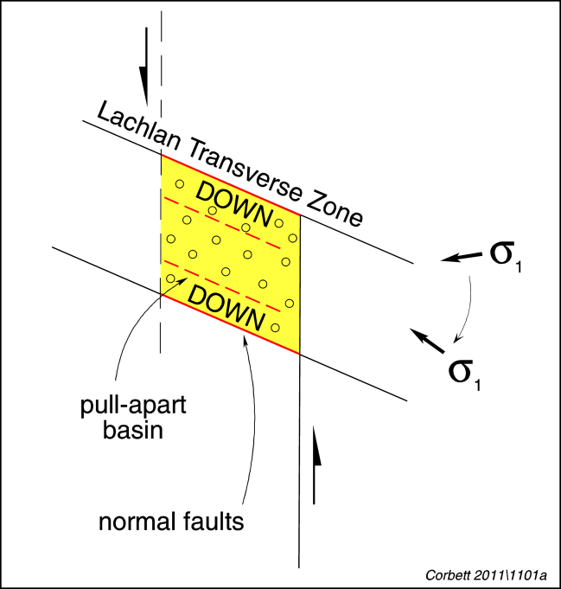
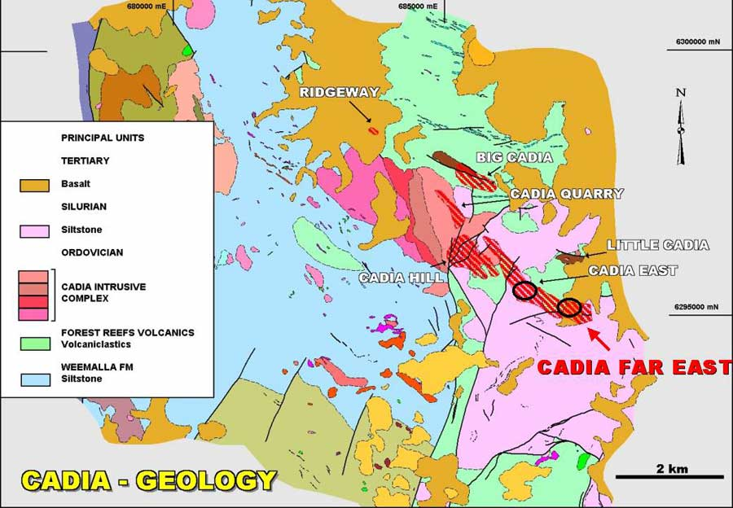
Mineralised growth faults
Cadia East
2,347Mt @ 0.44g/t Au & 0.28%Cu

Slide 11
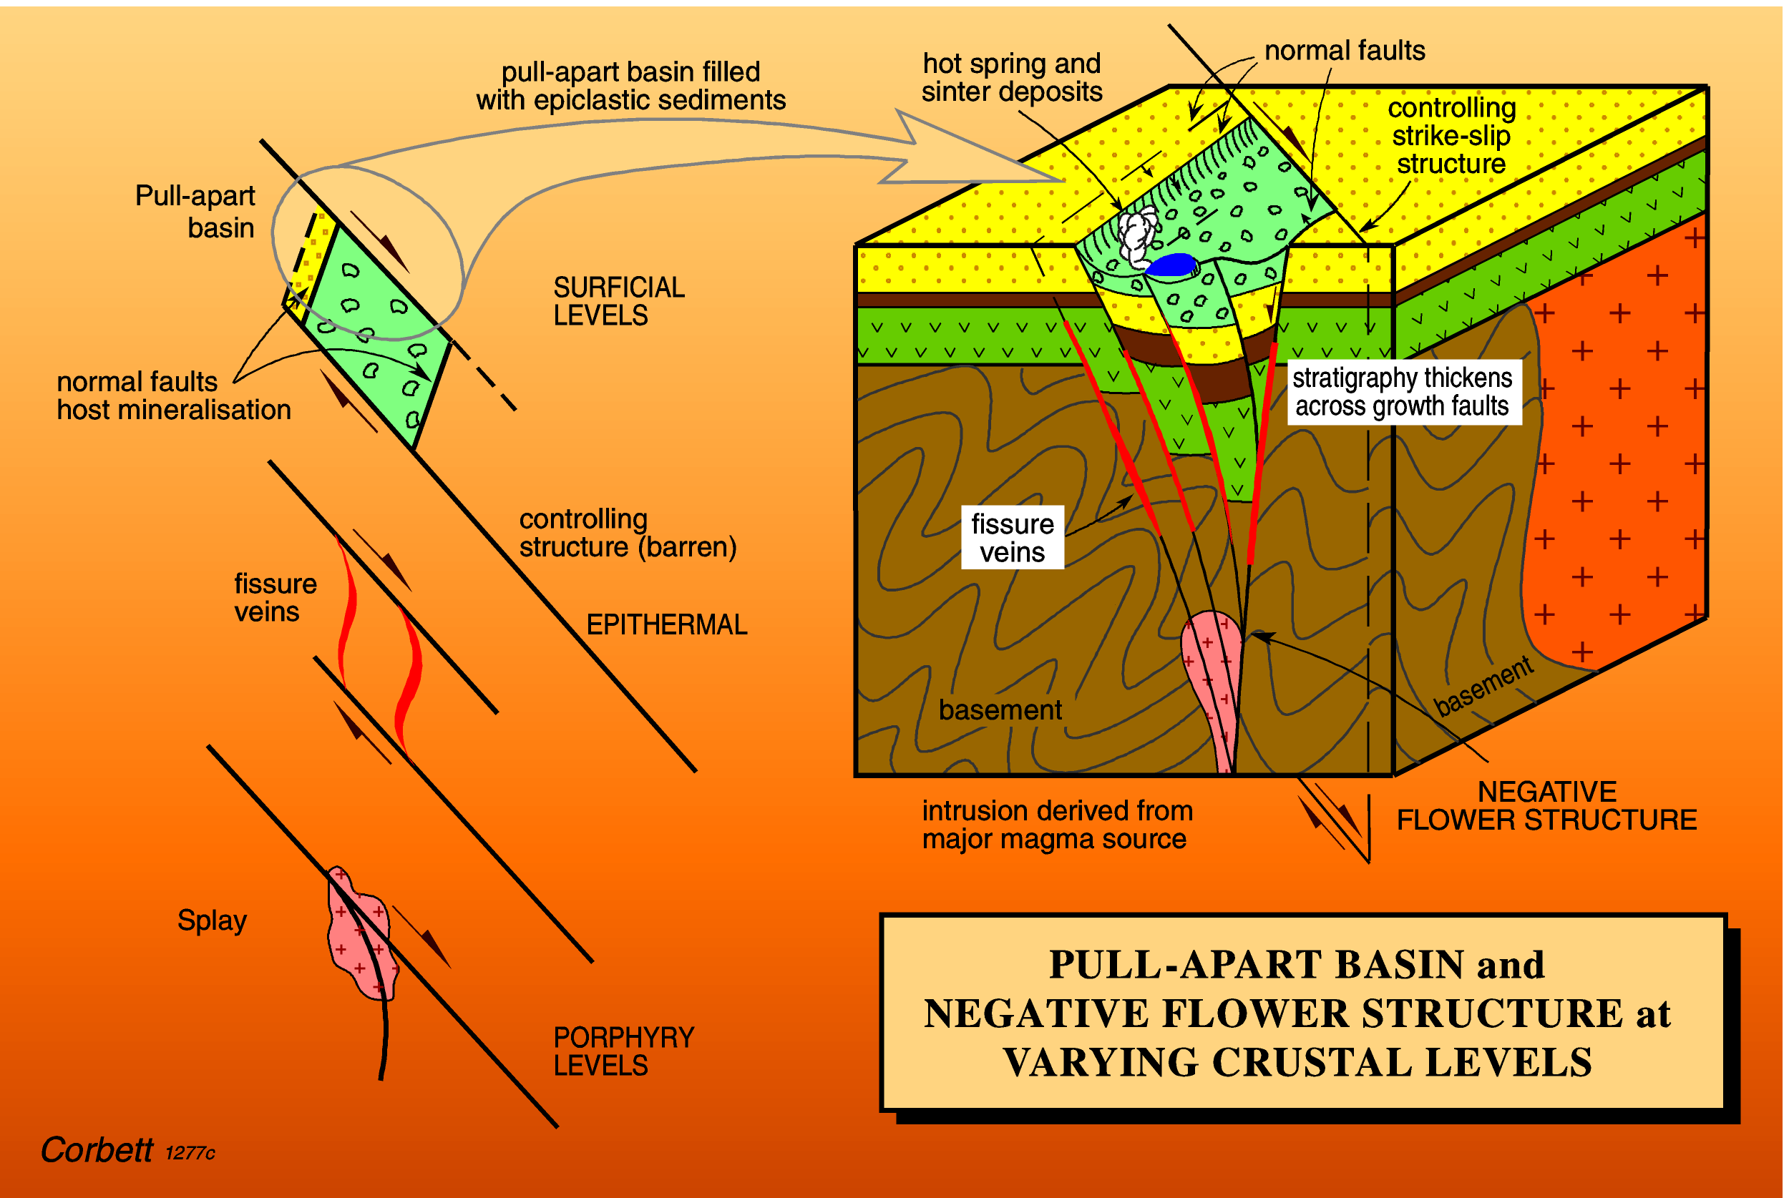
Structure in porphyry systems – localisation

Slide 12
Structural control to porphyry Cu-Au

Slide 13
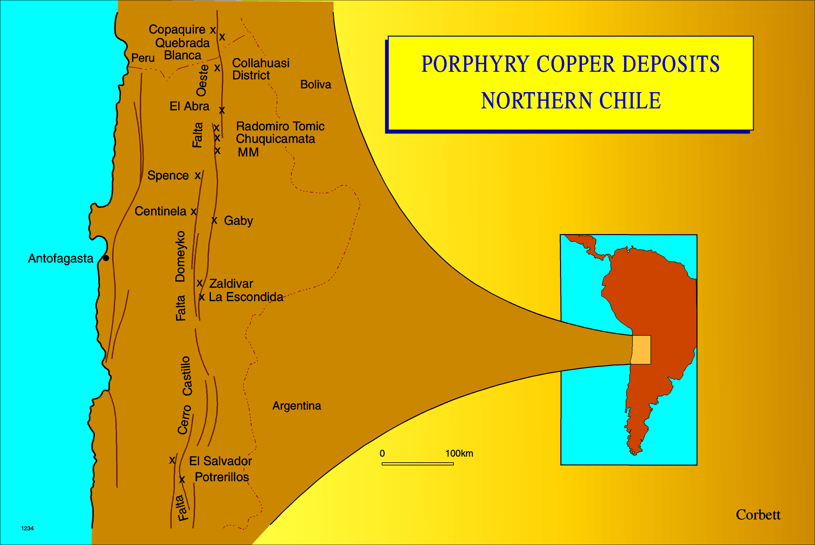
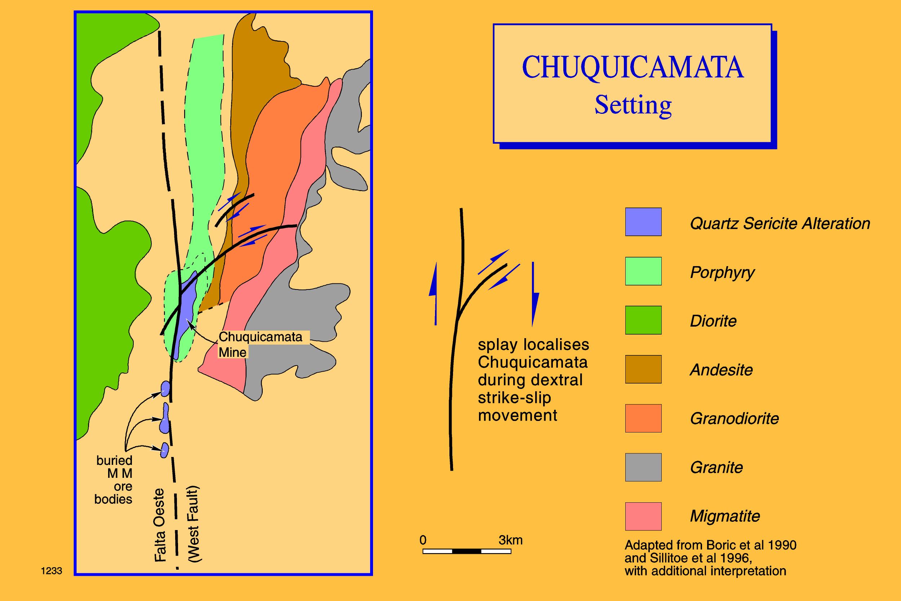
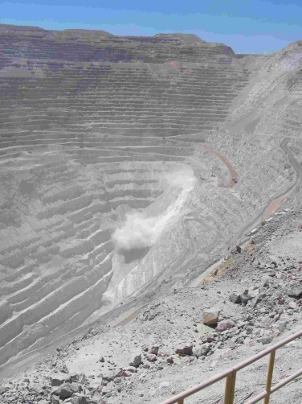
Arc parallel faults and Chuquicamata localised by a splay in oblique convergence

Slide 14
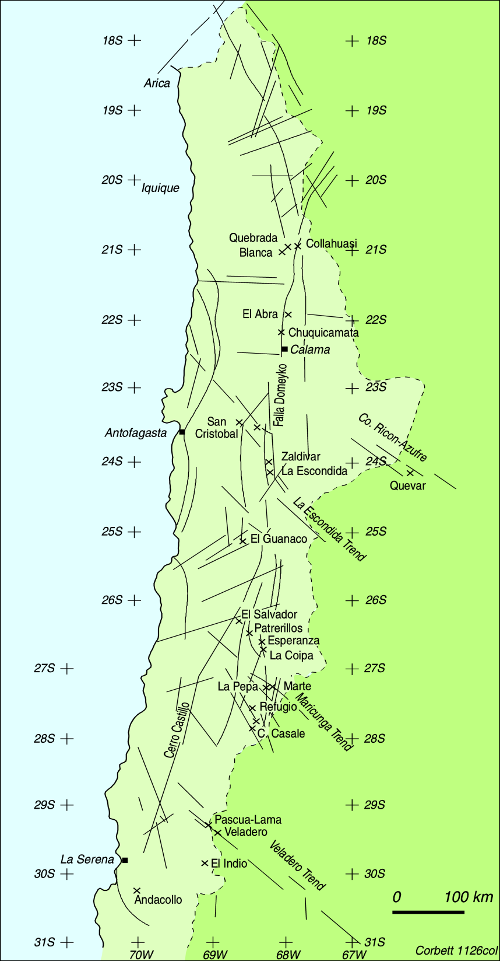
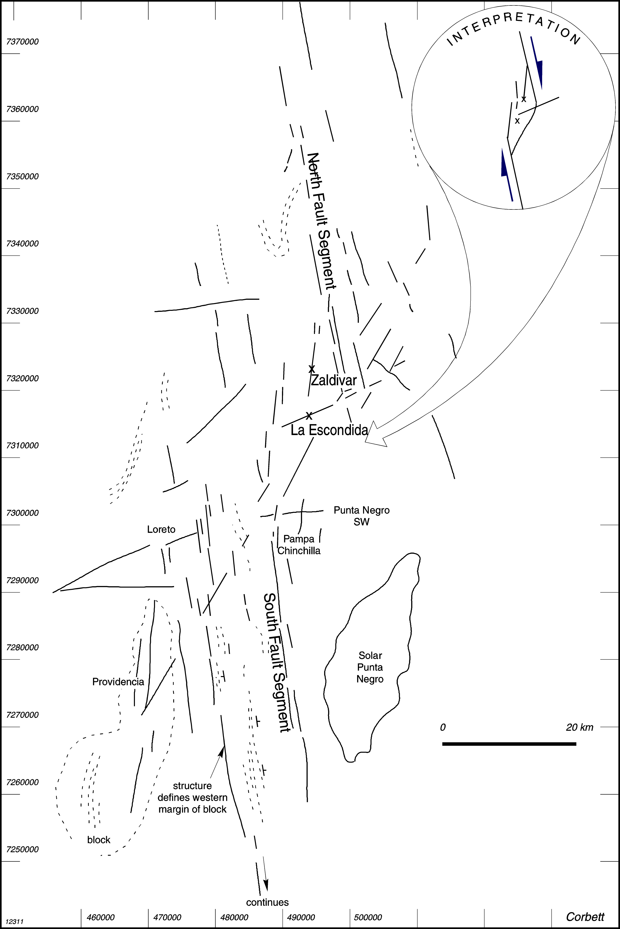
La Escondida
La Escondida

Slide 15
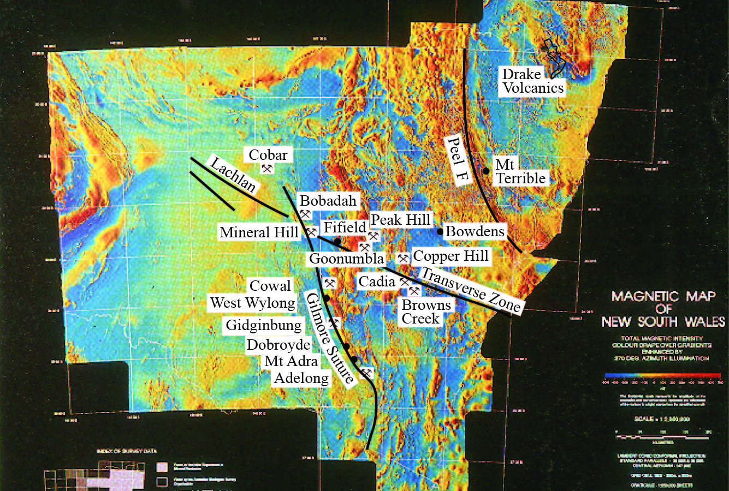
New South Wales

Slide 16
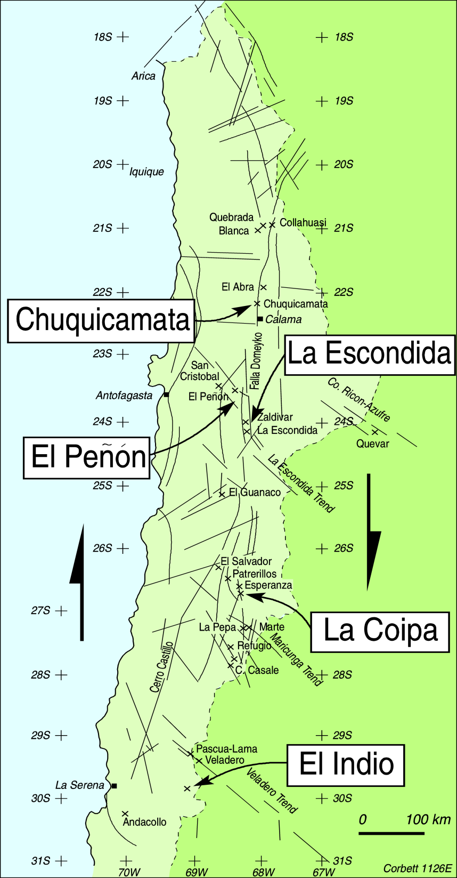
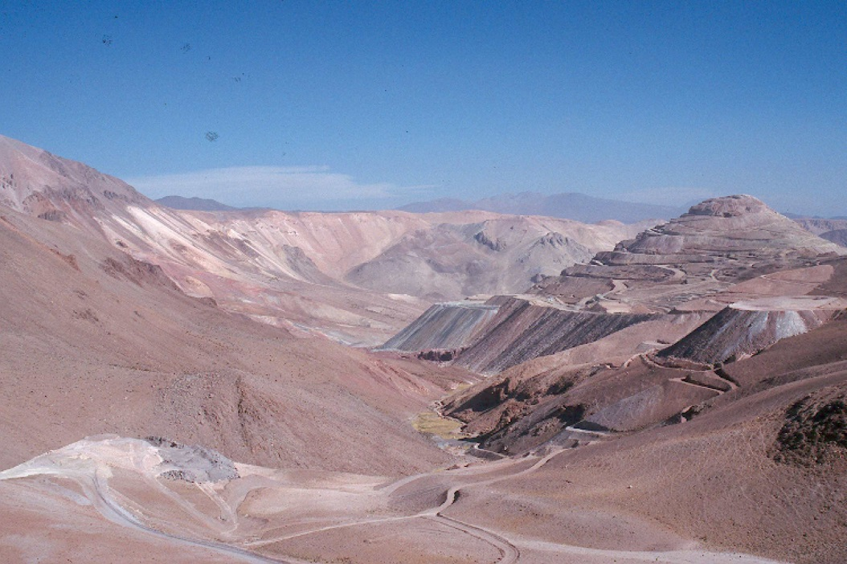
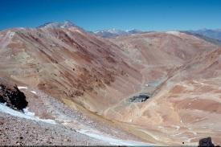
Dextral transpression
La Coipa
El Indio

Slide 17
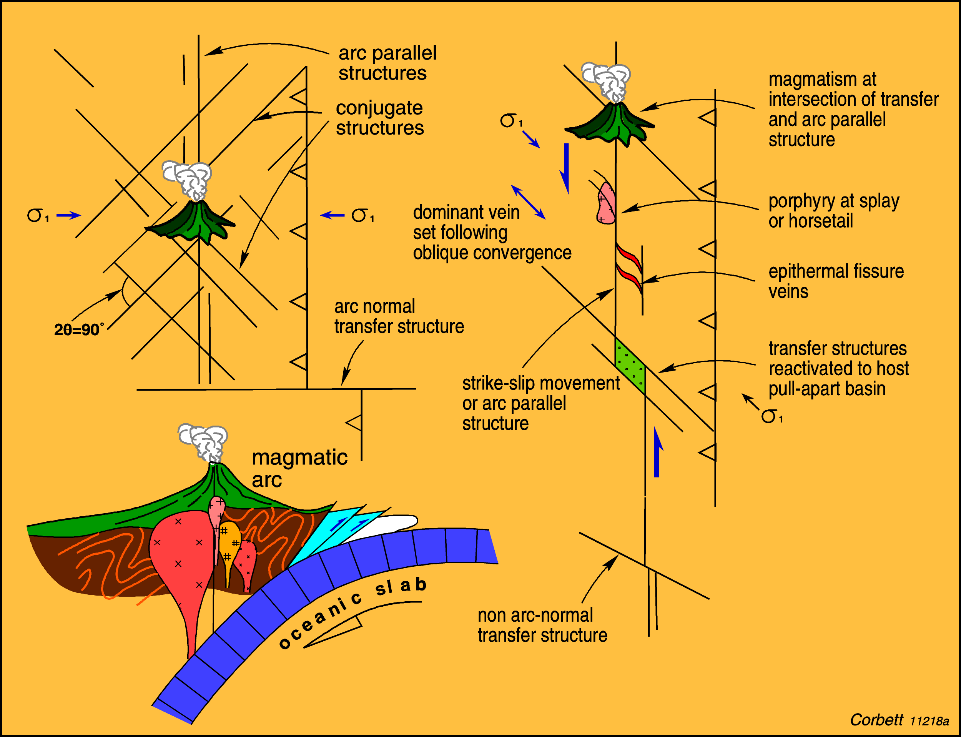
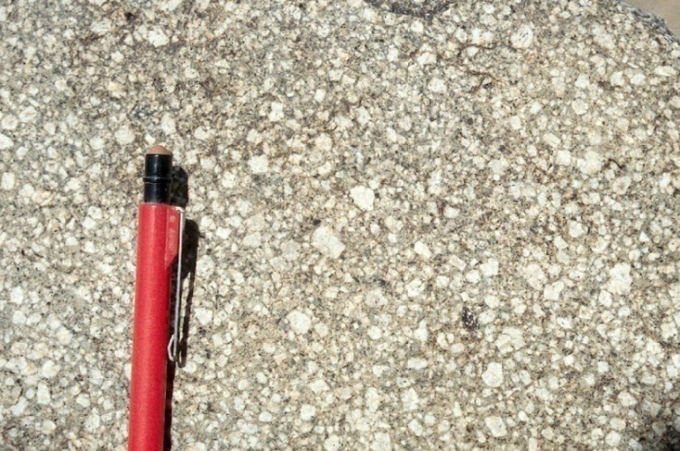
Changes in converge as a trigger for intrusion

Slide 18
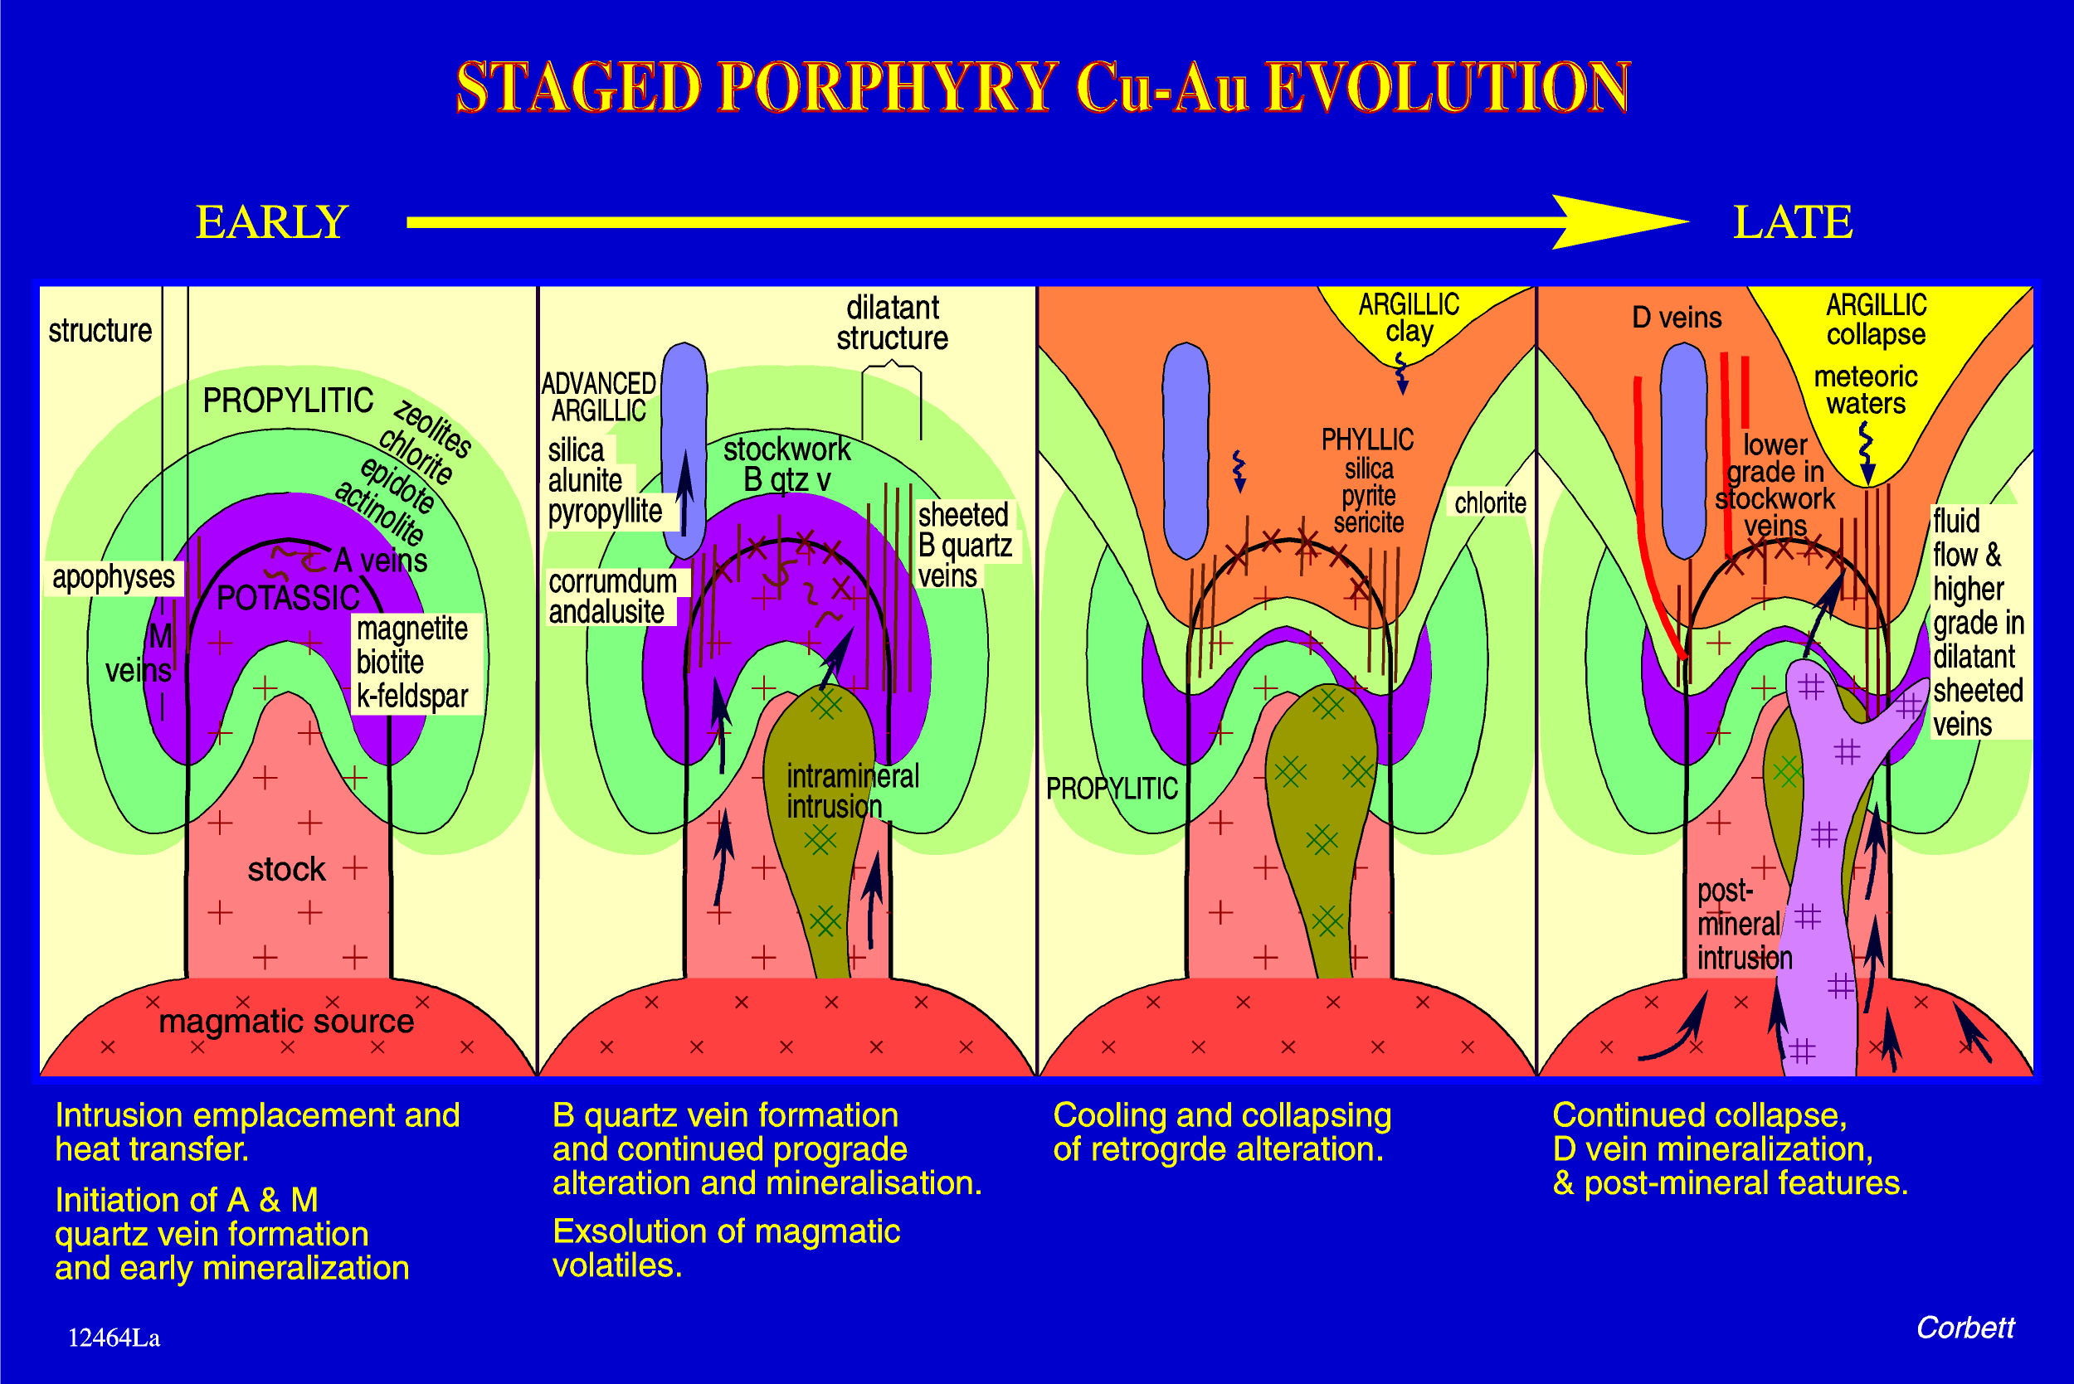
Vectors to blind porphyry Cu-Au

Slide 19
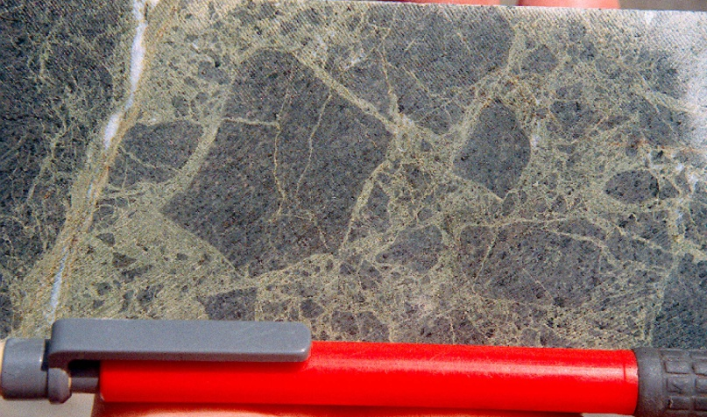
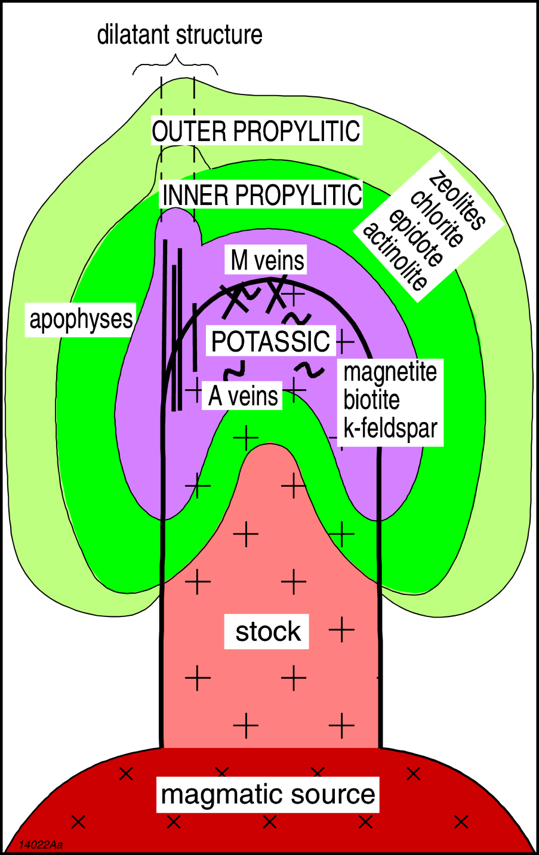
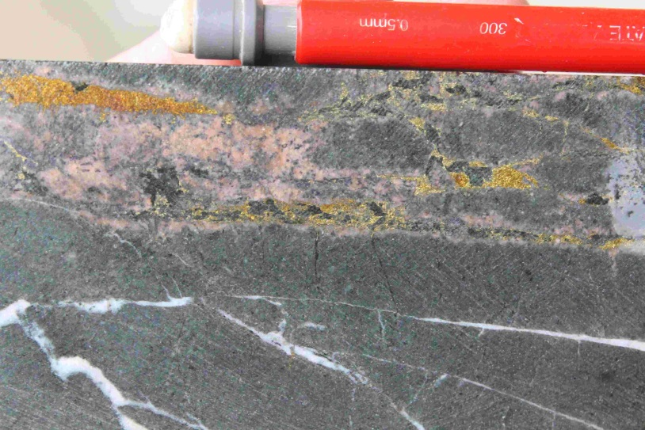
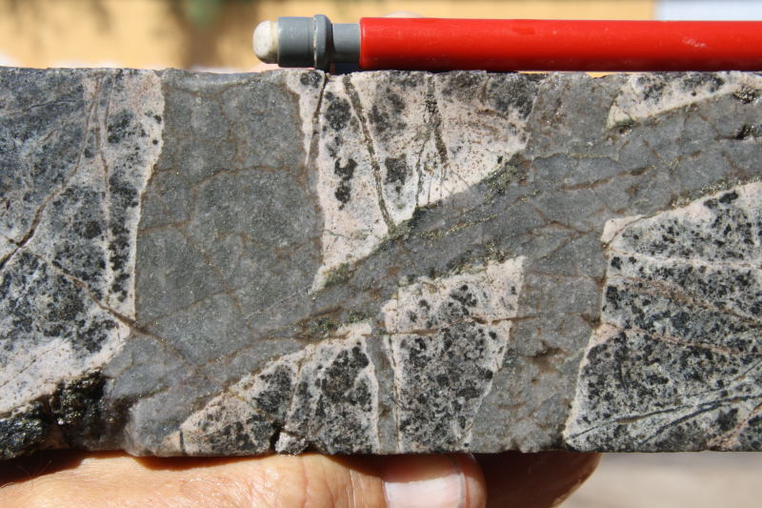
Zoned prograde alteration
Ridgeway
Caspice Chile

Slide 20
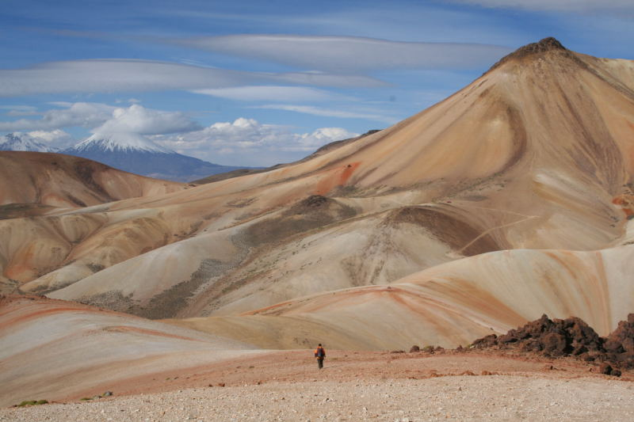
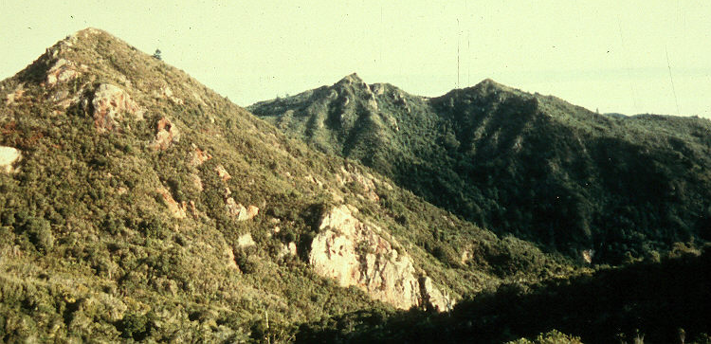
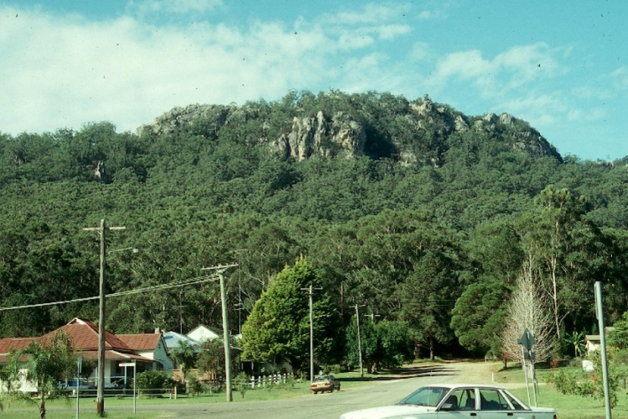
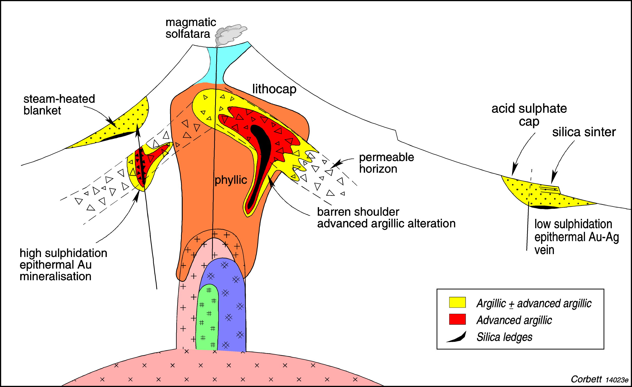
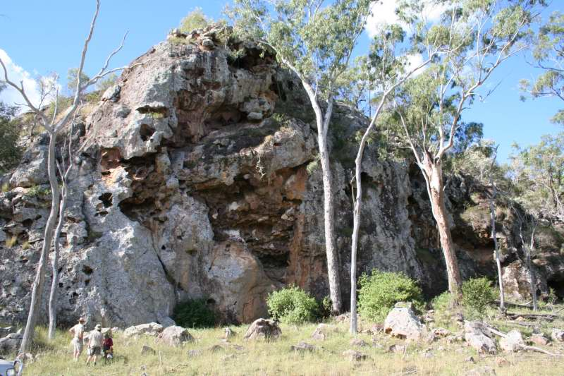
Barren shoulders vs lithocaps
Lookout Rocks New Zealand
Bulahdulah
Esk Trough

Slide 21


Wafi Alteration zonation
Modified from Corbett 2011
From Menzies 2013

Slide 22



Phyllic alteration
Silica-sericite with B vein Temora Australia
0.1 g/t Au & 0.11% Cu
La Arena Peru

Slide 23




D veins – sulphide lodes with sericite selvages
Bilimoia & Nakru Papua New Guinea
Rawbelle Qld & Stavely, Vic

Slide 24



Mineral Hill
Jacks Hut Lode
Parkers

Slide 25


15 g/t Au in a D vein

Slide 26
Styles of magmatic arc Cu-Au

Slide 27



Low sulphidation epithermal quartz-sulphide Au + Cu
Bilimoia Papua New Guinea
Lake Cowal, Australia

Slide 28





Variations in quartz-sulphide Au + Cu
Chatree,
Thailand
14 g/t Au
Mineral Hill
Lihir
Papua New Guinea
Drake

Slide 29




Quartz-sulphide Au Australia
Adelong
Paulsens, WA
Mt Wright, Qld
Burraga

Slide 30




Supergene enrichment

Slide 31




Supergene Au enrichment, Cirianiu, Fiji
Quartz-pyrite vein
Disseminated pyrite 2.49 g/t Au 1.8 g/t Ag
Supergene in a feeder structure 102g/t Au 40.5g/t Ag

Slide 32

Carbonate-base metal Au and polymetallic Ag-Au

Slide 33



Carbonate-base metal Au – Leach and Corbett, 1993, 1994, 1995; Corbett and Leach, 1998
Kelian
Porgera
Both dark sphalerite

Slide 34




Sphalerite zonation in carbonate base metal Au & polymetallic Ag-Au
San Martin
Peru
Kumrock,
Kamchatka,
E. Russia
Bowdens,
Australia
Kelian, Indonesia

Slide 35





Breccia hosted carbonate-base metal Au
Keillian

Slide 36





Drake Goldfield
2.5g/t Au
6 g/t Au
668g/t Ag

Slide 37



Emperor flatmakes

Slide 38




Drake caldera collapse
Lady Hampton
5.1g/t Au
Red Rock
6.6g/t Au

Slide 39



Cowal

Slide 40


Fluid evolution – two epithermal end members

Slide 41




Epithermal quartz Au + Ag style
Mt Boppy
Mineral Hill
Twin Hills
Lucknow

Slide 42






Cobar district
Pipeline Ridge
The Peak
New Occidental
Boppy South
CSA

Slide 43

Gympie

Slide 44


Slide 45


Low sulphidation Epithermal Banded Chalcedony-Ginguro Au-Ag veins
Formerly described as adularia-sericite
or quartz-adularia veins

Slide 46



Flexures in a throughoing structure, Vera Nancy, Australia long section

Slide 47

Sorpresa NSW – sediment hosted replacement
From D. Menzies

Slide 48






Sediment Hosted Replacement Au Structure and Lithology Control
Mesel, Indonesia, 2.35g/t Au
Miekle, USA, 15g/t Au
Realgar
AsS
Orpiment
As2S3

Slide 49
Styles of magmatic arc Cu-Au

Slide 50







High Sulphidation epithermal Au
MOST
HOT ACID
enargite
LESSER
HOT ACID

Slide 51



Fluid evolution Mt Carlton, Australia
Enargite ore with vs clast
Vughy silica
alunite

Slide 52



Mt Carlton mineralisation
Pyrite yellow sphalerite galena
700 g/t Ag
Visible gold

Slide 53


Transition from high to low sulphidation
Goldfield, Nevada

Slide 54






Fluid evolution El Indio, Chile

Slide 55






Skarn
Constantina Peru
vg
Mungana
Ertsberg
Cadia
Browns Creek

Slide 56
Lessons for Tasmanide exploration from the Pacific rim …
Importance of structures to localise porphyry epithermal
Triggers to porphyry-epithermal emplacement
Vectors from porphyry zonation in time and space
Styles of epithermal mineralisation as a guide to exploration
Skarns as host rocks and prospecting tools

Slide 57

Go to it yourselves!!

